Slide 1
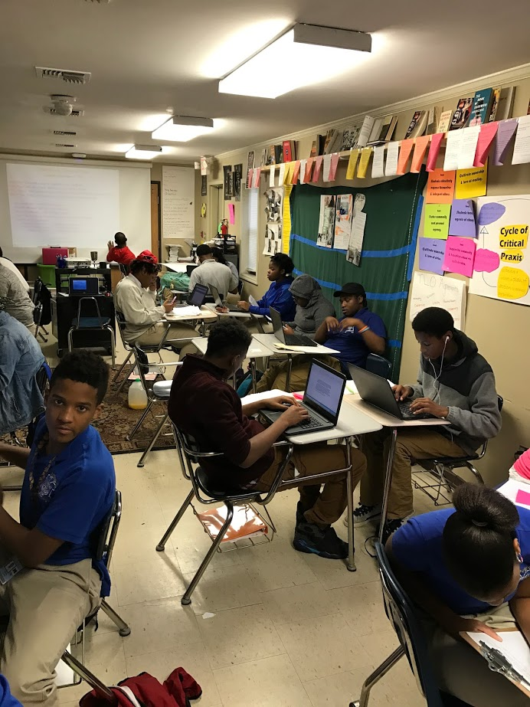
Opening Inquiry
Monday, January 9, 2017
Instructions for Independent Work (15 min.)
Put a heading in your CPAR Reading section with the title: Vision, Problem, Purpose
Read “Bill Ayers, Demand the Impossible! (Excerpt #8).”
Copy and finish this sentence: Ayers wrote this piece because…
Notes:
Supplies: laptops,

Slide 2
Today’s Agenda
Friday, December 16, 2016
Opening Inquiry
Meeting and Objectives
Independent Work:
Vision, Purpose, Problem, Questions
Grade filing and organization
Create Our Purpose & Problem
Create our Research Vision
Announcements:
MLK Day 1/16
We need 1/5 work from: Destiny, Alexius, Mya, Justin, Makaylen, Kierra
Objectives:
Identify a research vision.
Infer a research problem & purpose.
Create a research problem, purpose, and vision.
This Week in English Amped:
Monday: Research Problem, Purpose, & Vision
Tuesday: Input Surveys; Analyze Research Article
Writing Wednesday: Workshop on audience and Purpose + ORWS
Thursday: Input Surveys; Cycle of Critical Praxis; Continue to Analyze Research Article
Friday: Finish surveys; Restorative Justice; Featured Artists Friday
Notes:
Supplies: laptops,

Slide 3
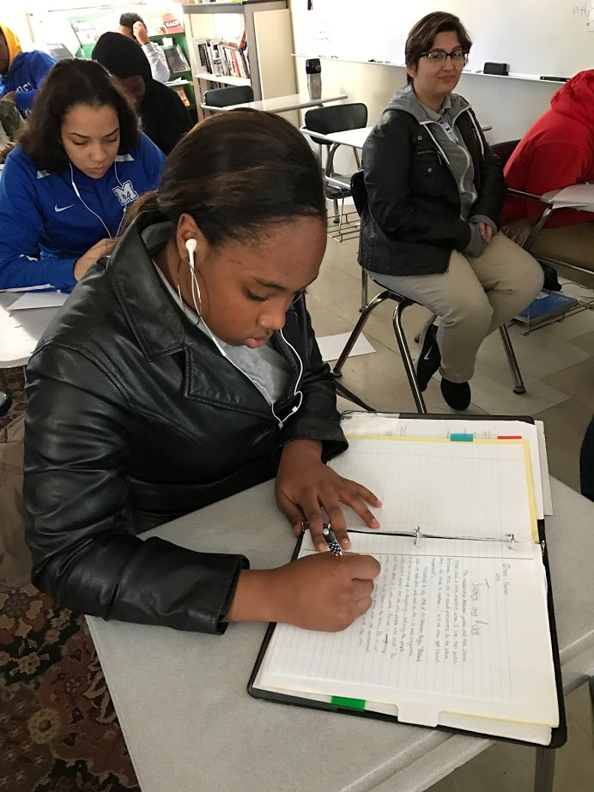
Independent Work
Friday, January 6, 2017
Bill Ayers’ piece is a concrete vision. What is a vision? Why do researchers need a vision?
Continue to work independently.
If you must ask a questions, ask your group before you ask teachers.
Use the text to answer the questions on the handout. Add your answers to the opening inquiry from today.
Notes:
Supplies: laptops,

Slide 4
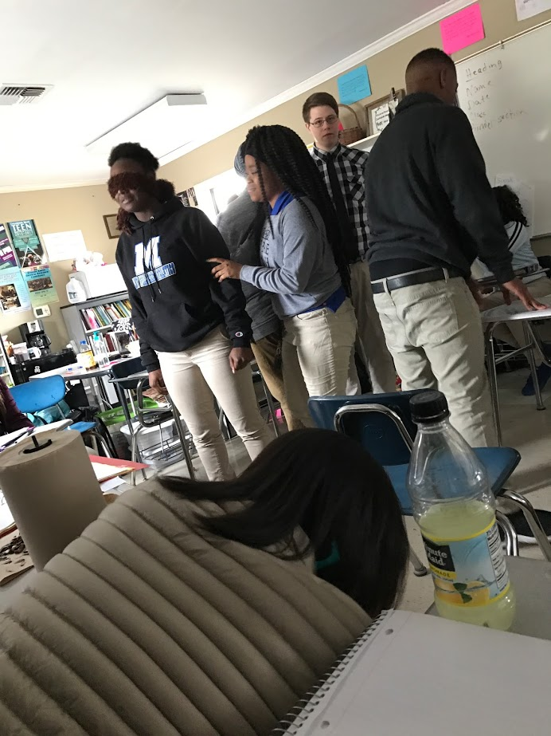
Collaborative Work
Friday, January 6, 2017
Compare group answers. Choose or create the best answer for your group to share with the class.
What is the purpose of this piece?
What is the problem?
How does Bill Ayers create his vision?
What is his purpose for creating the vision?
Notes:
Supplies: laptops,

Slide 5
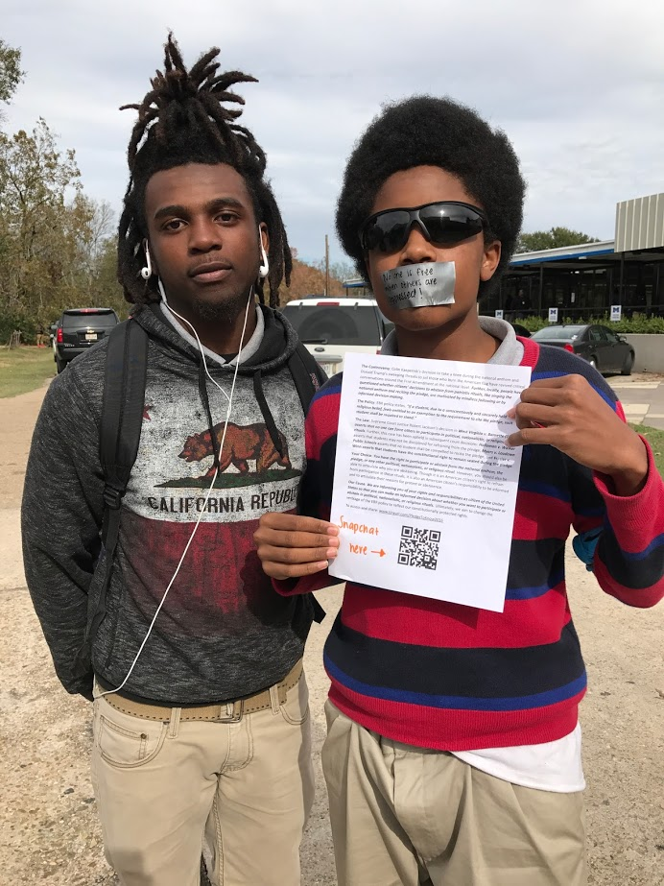
Research Purpose and Problem
Friday, January 6, 2017
Consider our research on school climate and student voice.
Create responses with your group to share with the class. Each person will add these responses to their classwork for today.
What is our research purpose?
What is our research problem?
Notes:
Supplies: laptops,

Slide 6
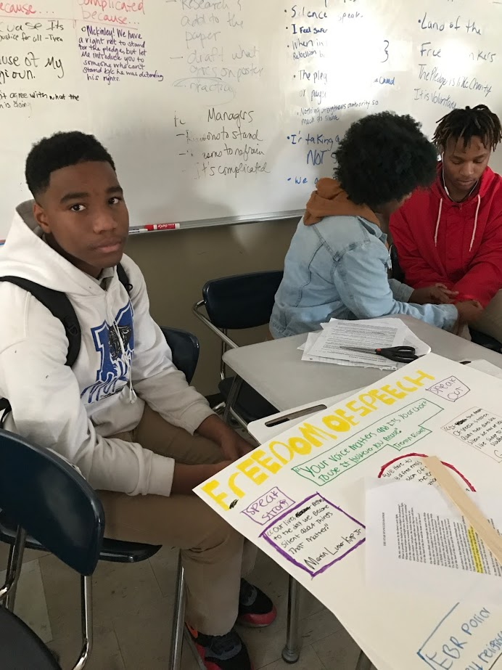
Research Vision
Friday, January 6, 2016
Consider the purpose and problem for our research on school climate and student voice.
Create a vision: Imagine McKinley as it could be if we achieved our research purpose and solved our research problem.
Create your personal vision.
You may use words, pictures, images, or any combination.
Create a collective vision by adding your vision to your class’s collage.
Notes:
Supplies: laptops,

Slide 7
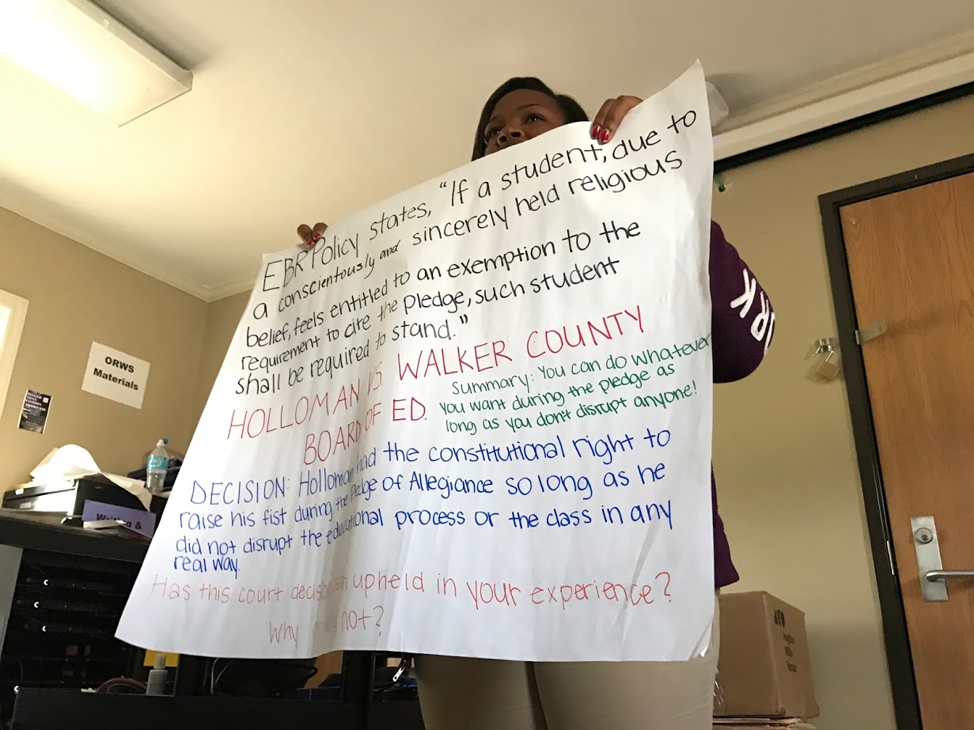
Reflection
Friday, January 6, 2016
What did we learn?
Objectives:
Identify a research vision.
Infer a research problem & purpose.
Create a research problem, purpose, and vision.
Notes:
Supplies: laptops,

