Slide 1
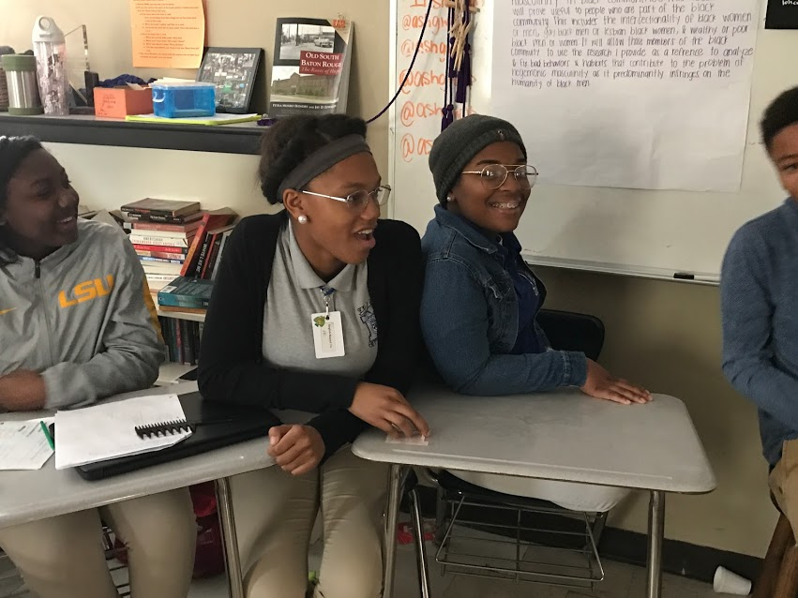
Opening Inquiry
Tuesday, January 17, 2017
Instructions (5 minutes)
Put a heading on a sheet of paper in your CPAR Reading section with the title: SOAPSToneS, Noregua.
Read over the SOAPSToneS resource. Write down questions you need answered to fully understand this resource.
Notes:
Supplies: laptops,

Slide 2
Today’s Agenda
Tuesday, January 17, 2017
Opening Inquiry
Meeting and Objectives
SOAPSToneS
Reflection
Announcements:
Snack Policy Update
Website Update
We need 1/5 work from: Mya, Justin
We need 1/9 work from:
Objectives:
Identify and analyze the speaker, occasion, audience, purpose, subject, tone, and style of a text using SOAPSToneS
This Week in English Amped:
Tuesday: See agenda.
Wednesday: Writing Wednesday—Formal Writing; ORWS
Thursday: Research Paper Draft 1
Friday: Choose book clubs, Restorative Justice circle
Notes:
Supplies: laptops,

Slide 3
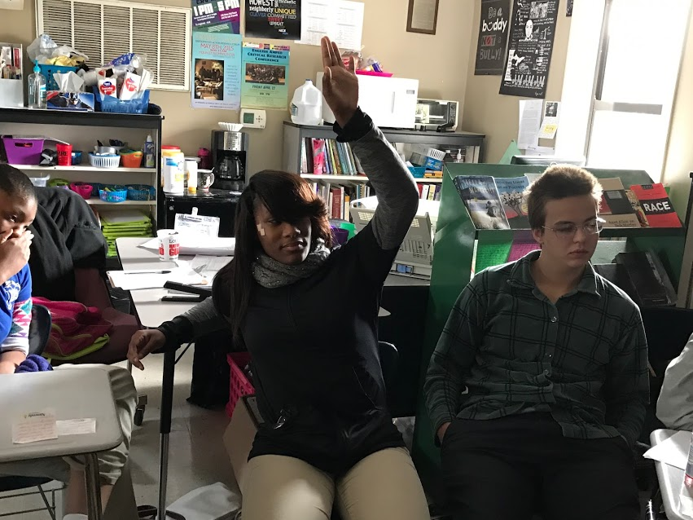
SOAPSToneS
Tuesday, January 17, 2017
Questions?
Speaker
Occasion
Audience
Purpose
Subject
Tone
Style
Notes:
Supplies: laptops,

Slide 4
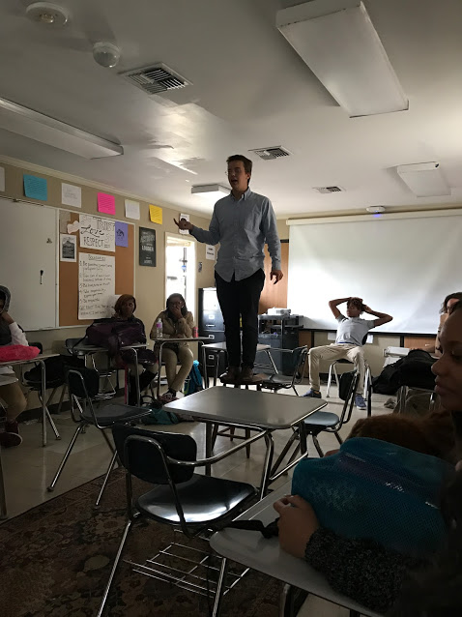
SOAPSToneS
Tuesday, January 17, 2017
Under your Opening Inquiry, write the subtitle:
Speaker
Read the blurb about the author on the bottom of page 1.
Read the “How listening to Students Can Be Incorporated Into Decision-Making” section.
Answer the questions about the speaker on the SOAPSToneS handout by discussing with your group and reaching consensus.
Each person will record the group’s responses on his or her paper.
Each group will share responses with the class and revise writing.
Notes:
Supplies: laptops,

Slide 5
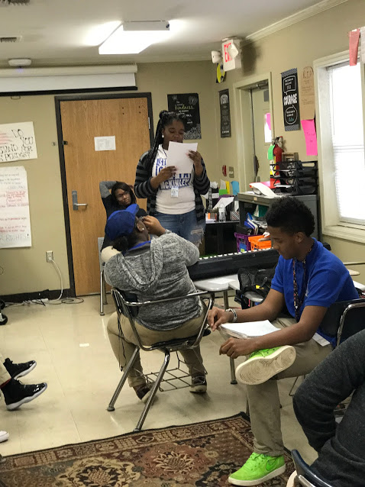
SOAPSToneS
Tuesday, January 17, 2017
Now write the subtitle:
Occasion
Read the opening of the article up until “Findings: Learning From Student Experience.”
Answer the questions about the text’s occasion, or context, on the SOAPSToneS handout by discussing with your group and reaching consensus.
Each person will record the group’s responses on his or her paper.
Each group will share responses with the class and revise writing.
Notes:
Supplies: laptops,

Slide 6
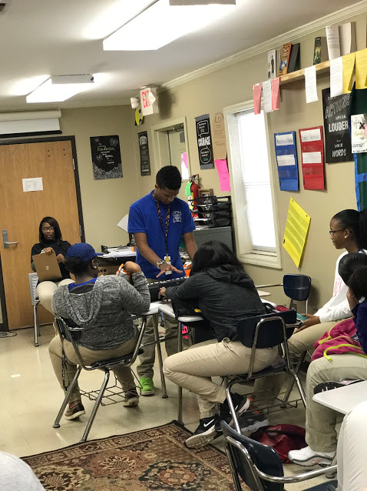
SOAPSToneS
Tuesday, January 17, 2017
Now write the subtitle:
Audience
Based on what you have already read, answer the questions about the text’s audience on the SOAPSToneS handout by discussing with your group and reaching consensus.
Each person will record the group’s responses on his or her paper.
Each group will share responses with the class and revise writing.
Notes:
Supplies: laptops,

Slide 7
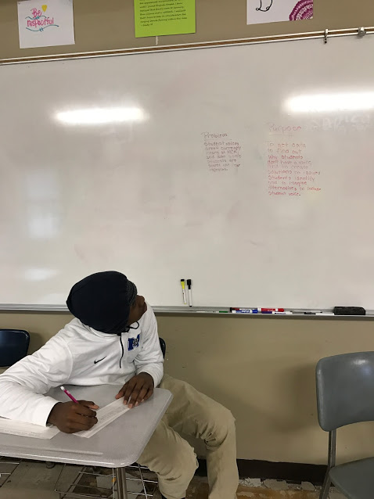
SOAPSToneS
Tuesday, January 17, 2017
Now write the subtitle:
Purpose and Subject
Based on what you have already read, answer the questions about the text’s purpose and subject on the SOAPSToneS handout by discussing with your group and reaching consensus.
Each person will record the group’s responses on his or her paper.
Each group will share responses with the class and revise writing.
Notes:
Supplies: laptops,

Slide 8
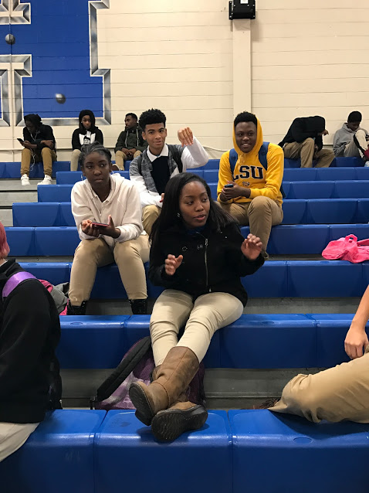
SOAPSToneS
Tuesday, January 17, 2017
Now write the subtitle:
Tone (Finish Th. 1/29)
Read over examples of tone on the handout.
Choose 20-25 strong verbs or adjectives from what you have already read. If you split up the text, each person can contribute 5 words.
Answer the questions about the text’s tone on the SOAPSToneS handout by discussing with your group and reaching consensus.
Each person will record the group’s responses on his or her paper.
Each group will share responses with the class and revise writing.
Notes:
Supplies: laptops,

Slide 9
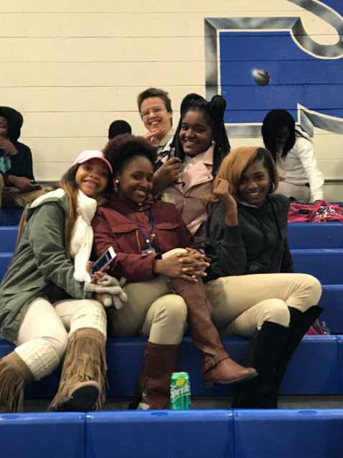
SOAPSToneS
Tuesday, January 17, 2017
Now write the subtitle:
Style (Finish Th. 1/29)
Based on what you have already read, answer the questions about the text’s style on the SOAPSToneS handout by discussing with your group and reaching consensus.
Each person will record the group’s responses on his or her paper.
Each group will share responses with the class and revise writing.
Notes:
Supplies: laptops,

Slide 10
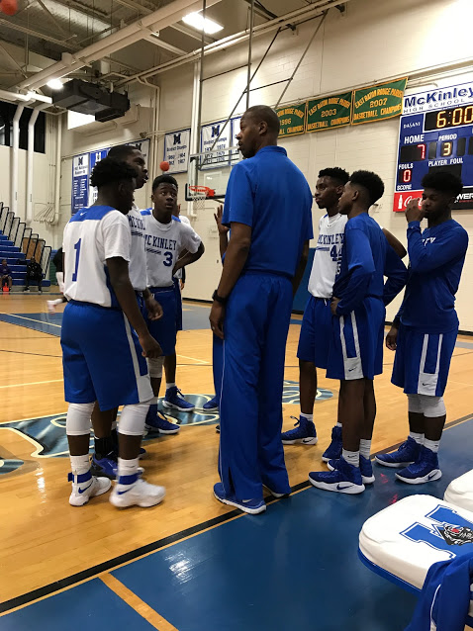
Reflection
Friday, January 12, 2017
Talk with your group, then prepare to share with the class:
What did we learn today about identifying and analyzing speaker, occasion, audience, subject, tone, and style using SOAPSToneS?
Notes:
Supplies: laptops,

