Slide 1
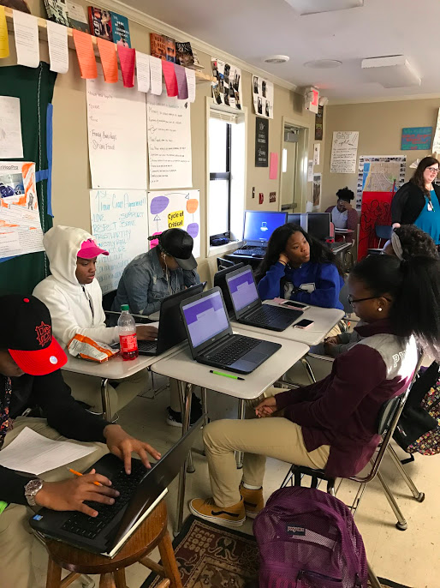
Opening Inquiry
Wednesday, January 18, 2017
Put a heading on a piece of paper in your Literary Analysis section. Title it “Formal Writing”. Using your excerpt about surfing, answer the following questions:
What is the purpose for this text?
Who is the intended audience for this text?
What parts of the text support your answers?
Notes:
Supplies: laptops,

Slide 2
Today’s Agenda
Wednesday, January 18, 2017
Opening Inquiry
Meeting and Objectives
Announcements:
Snack and Website Reminder
We need 1/5 work from: Mya, Justin
We need 1/9 work from:
Objectives:
Identify the characteristics of formal writing.
Analyze the context in which formal writing occurs.
This Week in English Amped:
Wednesday: See agenda.
Thursday: Research Paper Draft 1
Friday: Choose book clubs, Restorative Justice circle
Notes:
Supplies: laptops,

Slide 3
#1
It is unclear why surfing has found a broader respectability. Some point to the initial public offering of Quiksilver, the board apparel and accessories company, in 1986 as a catalyst. Perhaps reflecting surfing’s laid-back roots, concrete figures on participation are hard to come by. Two million people consider themselves active surfers in the United States, twice as many as 20 years ago, according to Action Sports Retailer, the leading board-sports industry trade show.
Notes:
Supplies: laptops,

Slide 4
#2
Modern surfboards are constructed of a plastic foam core that is shaped by hand or machine and then covered with a shell of fiberglass and resin. Individual surfboards can vary in dimensions. The high performance surfboards used by top professional competitors are typically about 1.8 to 2 m (6 to 6.5 ft) long, 47 cm (18.5 in) wide, less than 6 cm (2.5 in) thick, and weigh about 2.7 kg (6 lb). These boards are also known as shortboards. On the other end of the surfboard spectrum is the longboard. Most longboards are 2.7 (9 ft) long, 51 to 56 cm (20 to 22 in) wide, and about the same thickness as shortboards. They weigh less than 7 kg (15 lb).
Notes:
Supplies: laptops,

Slide 5
#3
Wow… definitely a night and day scenario. Headed out to DH early yesterday morning for a quick surf on the Bing. Small kine waves rolling through with hardly a wisp of wind. Super fun to be loggin it again. Good chance for me to get back into shape before going back to the northshore. Managed to get one killer wave… it walled up about waist high for a nice long hang ten, then back stepped as it pitched a bit to get a teeny weeny coverup, more like water splashing on my shoulder, but felt good. Zipped through that section and the wave opened up again for another noseride with a fade back. Good fun and all to myself!
Notes:
Supplies: laptops,

Slide 6
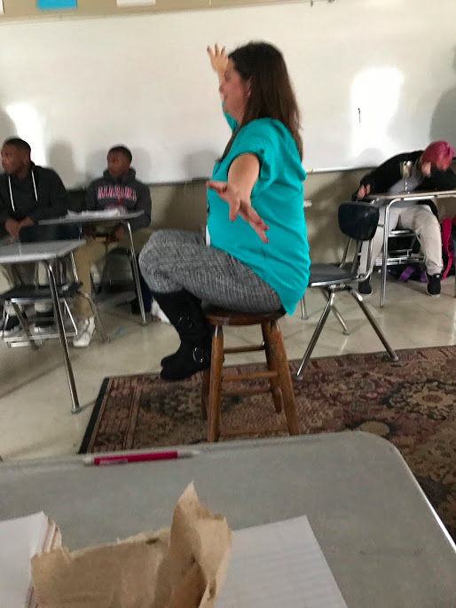
Writing
Wednesday, January 18, 2017
Instructions
Read the text out loud as a group.
As you read, circle the characteristics under “Formal” and “Informal” that best match the writing style.
Use the characteristics of formal writing to figure out whether your text is formal or informal.
Notes:
Supplies: laptops,

Slide 7
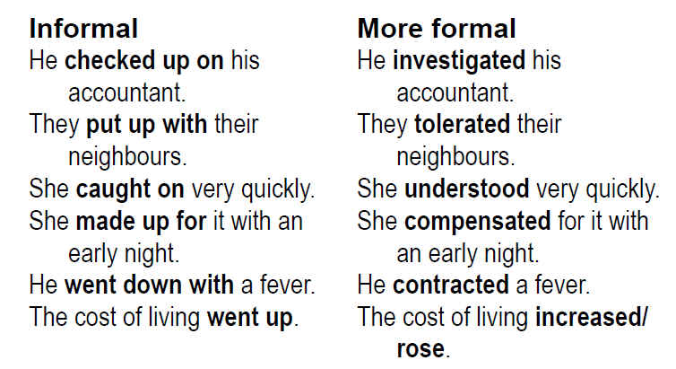
Phrasal verbs
Notes:
Supplies: laptops,

