Slide 1
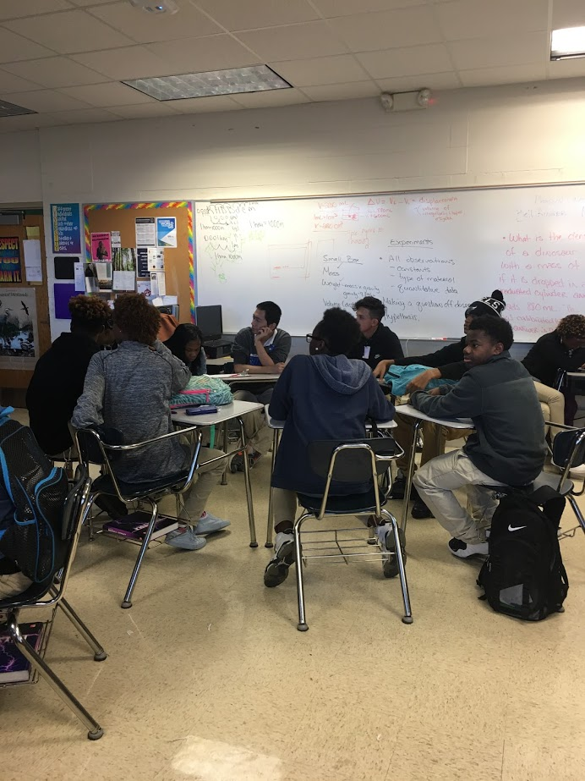
English Amped
Opening Inquiry
Monday, January 23, 2017
Instructions (5 min.):
Get your computer and open the Hr Name Research Draft 1 document in your home drive. Write down a response to these questions under the problem statement:
Think back to the research we conducted in the fall. What steps have we taken as researchers so far?
You will email this document to Mr. Moore and Mrs. Cooper at the end of class today.
Notes:
Supplies: laptops,

Slide 2
Today’s Agenda
Monday, January 23, 2017
Opening Inquiry and Meeting
Context: Intro
Writing a Research Context
Using Text Evidence
Reflection
Announcements:
Check your missing work sheet and complete by going to the website on your time.
Objectives:
Describe a research context (setting and occasion) of McKinley High School and the educational context of the nation as a whole
This Week in English Amped:
Monday: Research Context
Tuesday: Book Clubs—Setting
Writing Wednesday: Personal Narrative Workshop
Thursday: Book Clubs—Imagery; RATE Friday: Music Appreciation; Repetition Workshop; Featured Artists Friday
Notes:
Supplies: laptops,

Slide 3
I can’t believe I got a B- on my test!
Donald Trump is going to be a great President.

Slide 4
I can’t believe I got a B- on my test!
Is this higher or lower than what this student normally makes on his tests?
Donald Trump is going to be a great President.
Who is saying this?
When did they say this?
Why did they say this?

Slide 5
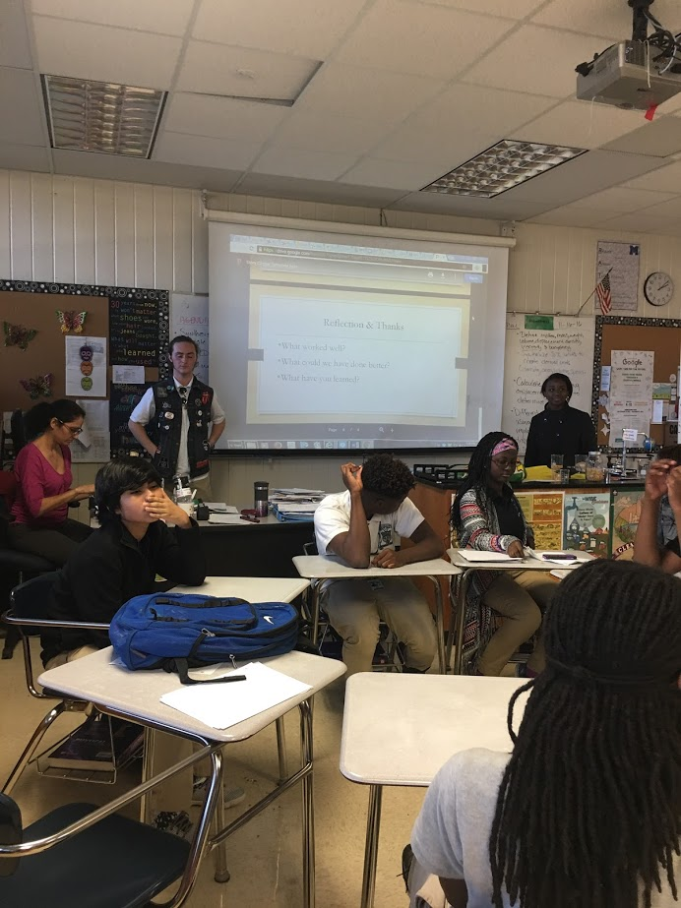
Context/Occasion: What is it?
The setting, but broader
Instead of just “Where” and “When,” occasion also looks at the “Who” and the “Why”
Consider the ideas, attitudes, and emotions that are involved with setting and where these ideas, attitudes, and emotions come from
When thinking of context, consider the social and cultural influences that create the instance you are observing

Slide 6
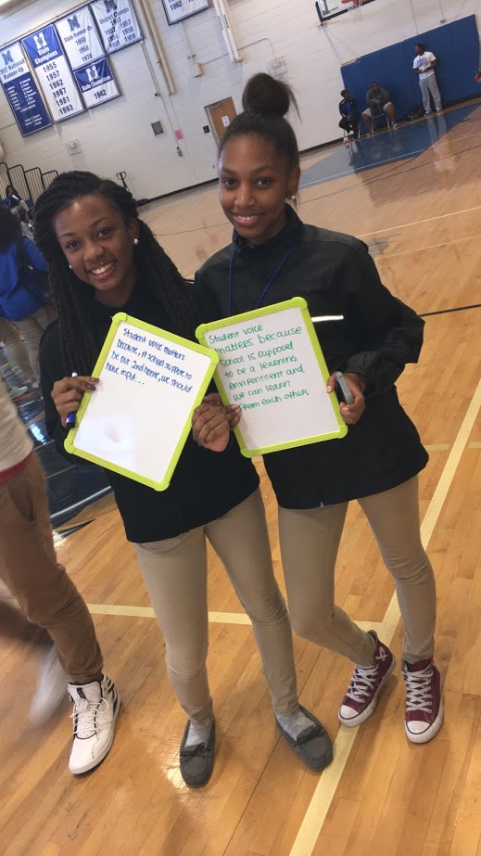
Context/Occasion: Why does it matter?
As readers, it helps us better understand why the events we read about occur the way they do
As researchers, it helps us have a better grasp on the problem we are trying to fix and the purpose of our research
Exposes biases that are related to our social and cultural environments

Slide 7
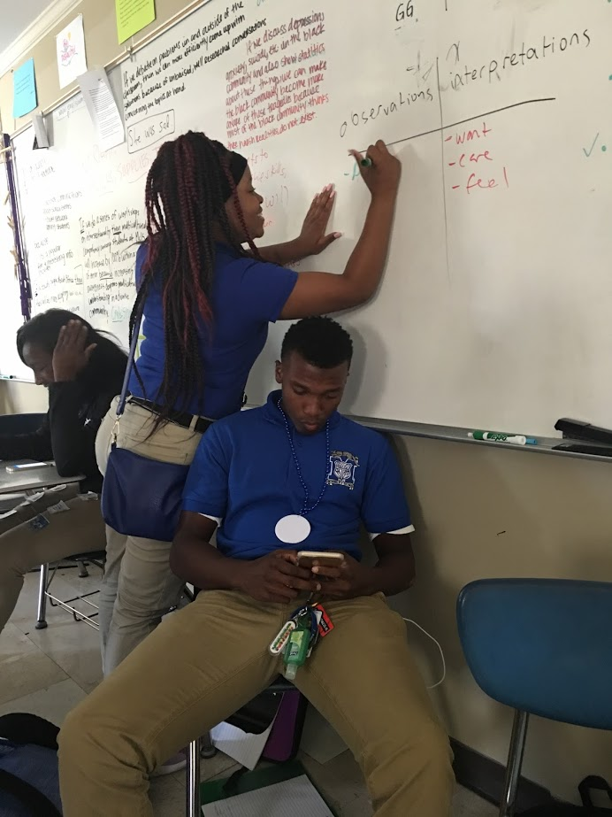
Between your “Research Problem” and “Research Purpose” type the title:
Research Context - McKinley
Using the handout on context, think about our own research problem and purpose at McKinley, respond to the Occasion questions under the Writing/Composition section of the SOAPSToneS handout
Each person will record the group’s responses on his or her paper.
Each group will share responses with the class and revise writing.
***The time is NOW, the speaker is YOU, and the text/piece is YOUR RESEARCH!

Slide 8
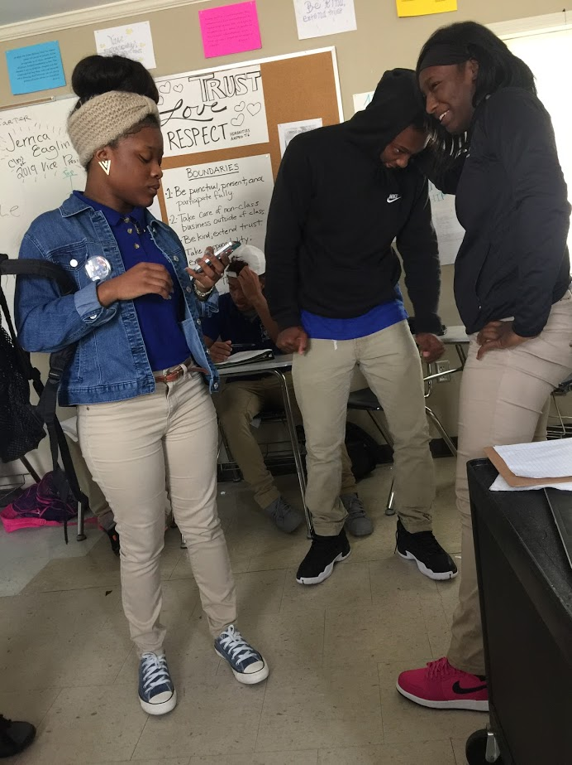
Now, under what you’ve just written, type the title:
Research Context – The Nation
Using the context handout, consider our research problem and purpose in respect to the current education system in America and respond to the Occasion questions under the Writing/Composition section of the SOAPSToneS handout.
Each person will record the group’s responses on his or her paper.
Each group will share responses with the class and revise writing.
***The time is NOW, the speaker is YOU, and the text/piece is YOUR RESEARCH!

Slide 9
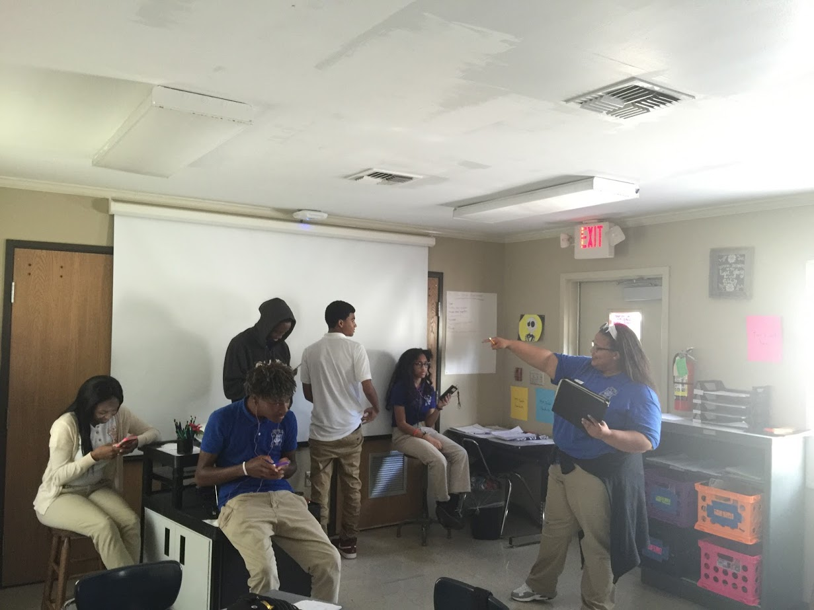
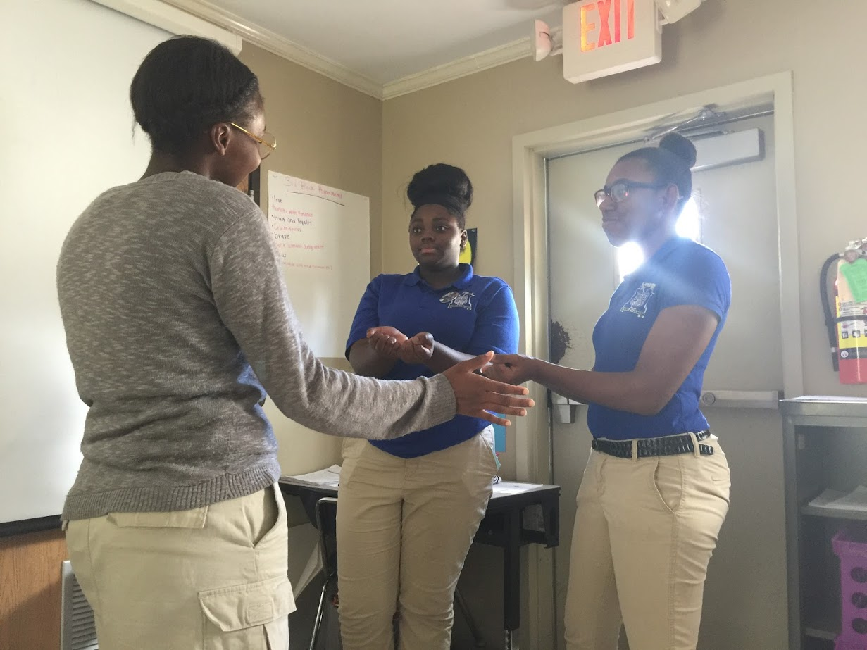
Using the Noguera article, find text evidence to add to your context that supports the context you describe for McKinley and the nation.
Use this structure: For example, Pedro A. Noguera states, “QUOTE THE TEXT” (###).
After the quote, explain what the quote means: This means that…
After that, explain how the quote supports your context: Therefore…
***Think of this as a RATE Paragraph

Slide 10
Email your document
1.) Log in to your gmail or whichever email provider you use
2.) Click on the compose button (this should be located on the right or left side of the screen)
3.) Type destinyadamscooper@gmail.com hit enter and type rmoor57@yahoo.com and hit enter again
4.) Write the subject as: “Last Name – Research Draft”
5.) Click on the paper clip icon at the bottom of the email
6.) Find the document you were just working on and double click it
7.) Send the email

Slide 11
Read your novel until it is time for reflection.
Your first section is due tomorrow.
You will complete a book club sheet at the beginning of class.

Slide 12
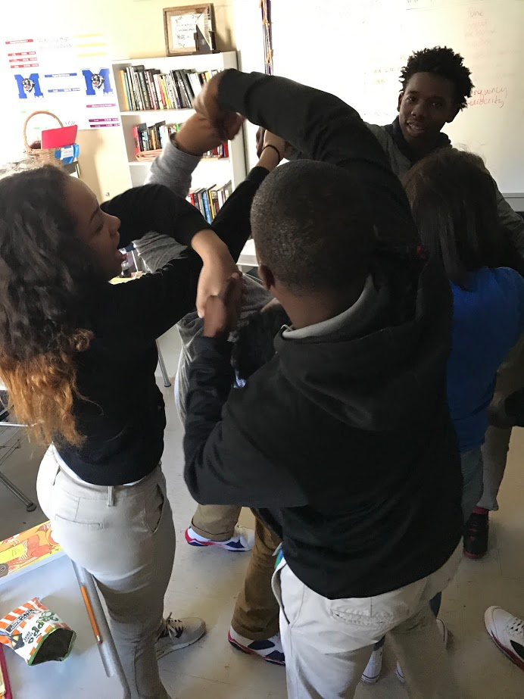
Reflection
Monday, November 28, 2016
What did we learn about the context of our research at McKinley and in the nation as a whole?
What did we learn about identifying and analyzing context?
Objectives:
Describe a research context (setting and occasion) of McKinley High School and the educational context of the nation as a whole
Identify and analyze context in nonfiction
Notes:
Supplies: laptops,

