Slide 1
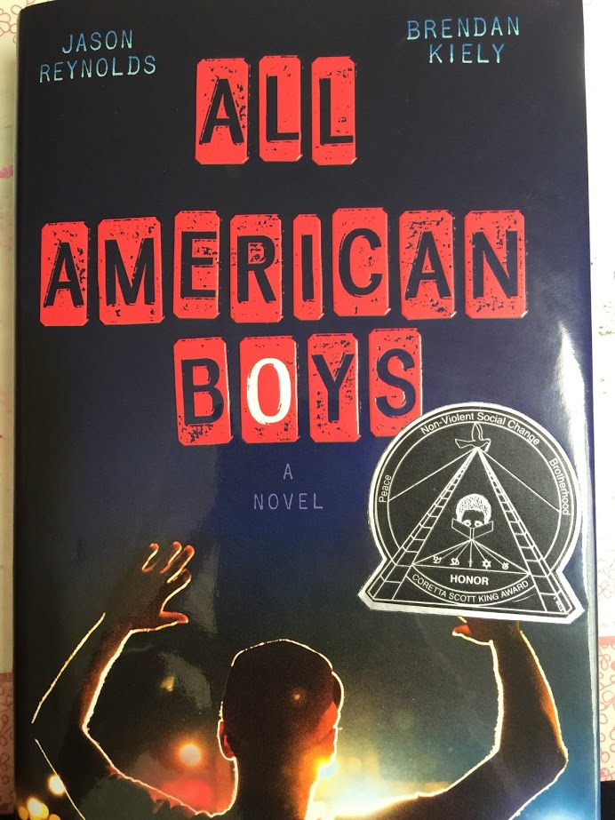
English Amped
Today’s Agenda
Friday, September 9, 2016
Restorative Justice Circle
Agreements
Jobs
Announcements:
REMIND: @G3CBA to 810-10
PSAT Test: $15 due by 10/19 in B106
Futures Fund Application: Digital and Visual Arts Saturday classes 8-12:30 (www.EnglishAmped.weebly.com)
IDs: 1st Hr. Tuesday; 2nd Hr. Monday 3rd Hr. Today; 4th Hr. ???
OPEN HOUSE: 9 AM TOMORROW!
Notes:
Supplies: laptops,

Slide 2
Restorative Circles
Why Restorative Circles?
To better communicate
To solve problems
To make things right
Sometimes we use circles to build community, and sometimes to solve problems.

Slide 3
Restorative Circle Process Moved to Friday for 1st and 3rd.
Make a good circle, one where we can all see one another’s faces
A centerpiece gives us a peaceful center– bring something to add to it!
A talking piece gives us a way to honor the speaker

Slide 4
Opening Poem & Check In Round
“Remember” by Joy Harjo
Who do you respect, and why?
2-3 people who haven’t shared.
What qualities do those we respect have?

Slide 5
Our Class Agreement Moved to Friday for 1st, 3rd, and 4th)
For our class to be a safe space where we can all do our best work, we must…
Make agreements about how we will behave and treat one another.
Have consensus about our agreements. (Fist to Five)

Slide 6
Our Class Agreement
What do you need for our class to be a safe space where we can all do our best work?
Write one need per sheet.
Slap them on the wall. Cluster.
Seek consensus with Fist to Five.

Slide 7
Agreement Rules
Anyone can ask for an agreement at any time
Anyone can ask to modify an agreement at any time
If there is not consensus about a proposed agreement, it is not an agreement.
Maintaining the agreement is everyone’s responsibility.

Slide 8
Close the Circle
3-5 volunteers: Share what you are thinking and feeling about your experience today.

Slide 9
Job Brainstorm: What else?
Opening Meeting Facilitators | Lead the opening meeting at the start of class each day.
Celebration Coordinators | Plan and coordinate celebrations!
Community-Building Game Leaders | Plan and lead community-building games.
Room Squad | Make our classroom beautiful and keep it that way!
Reflection Leaders | Lead reflections.
Featured Artist Fri Hosts | Host the open mic.
McKinley Lunch Open Mic Coordinators | Plan and host we bi-weekly open-mic.
Photographer | Take and upload pictures.
W

Slide 10
Jobs: One More Path to Ownership
Read over the job brainstorm.
What ideas for other jobs do you have? Add to the brainstorm.
LOOSELEAF PAPER:
Heading
List top 3 jobs you would want to have and say why you should get that job.

