Slide 1
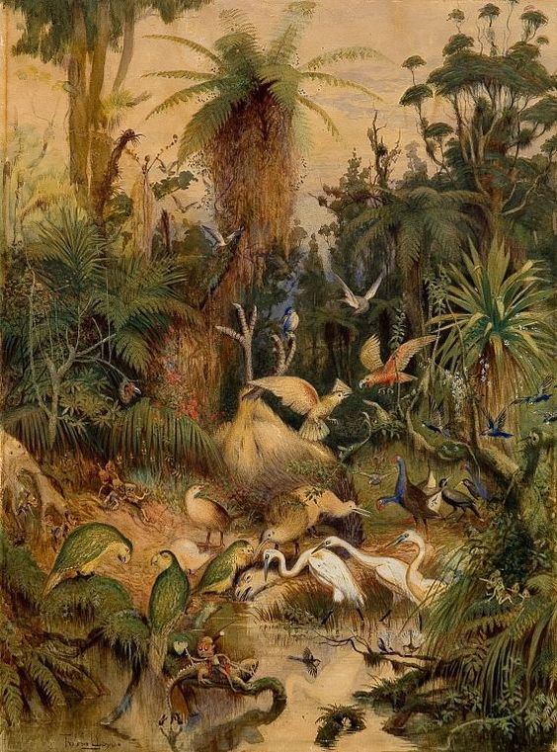
Opening Inquiry
Tuesday, September 20, 2016
Instructions:
English Amped
Notes:
Supplies: laptops,

Slide 2
English Amped
Today’s Agenda
Tuesday, September 20, 2016
Opening Inquiry
Writing Workshop
Announcements:
REMIND: Text @6a9hh to 810-10
PSAT Test: $15 due by 9/22 in B106
Photographers: www.tinyurl.com/2017-EngAmpPhotos
(www.EnglishAmped.weebly.com)
Notes:
Supplies: laptops,

Slide 3
Writing Workshop
.

