Slide 1
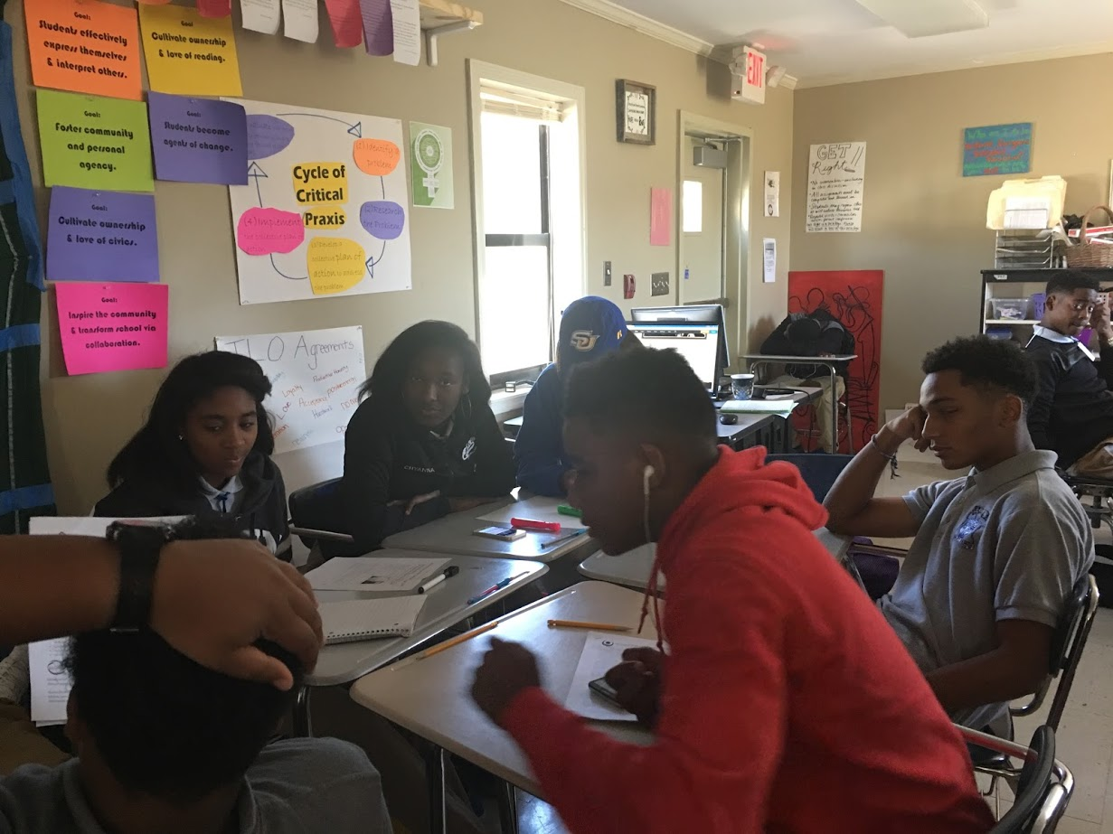
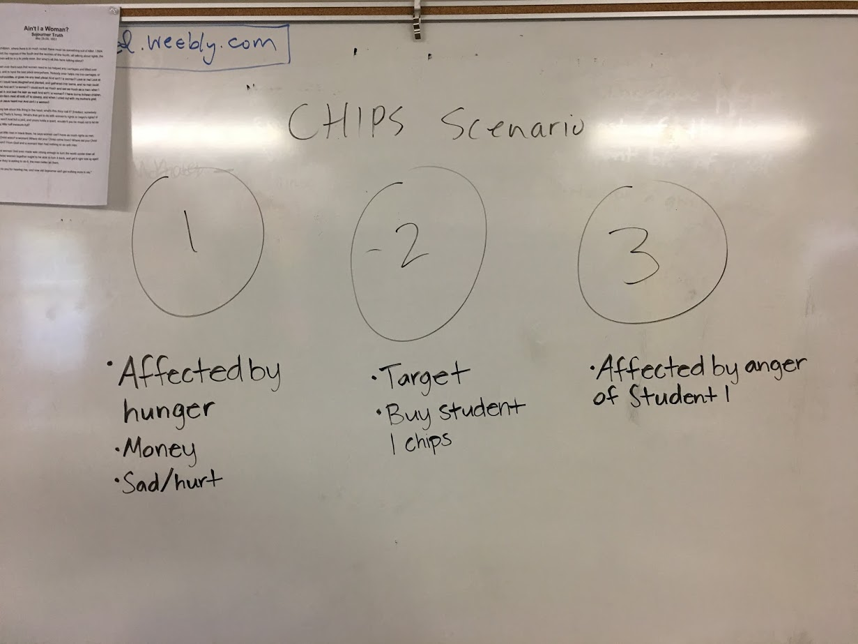
English Amped
Opening Inquiry
Friday, October 7, 2016
Objective:
Build our learning community, and
Explain and investigate school climate and student voice
Instructions:
Put a heading on a paper in your CLASSWORK section with the title: Ripples.
Answer in any format:
What is an example of a time when something someone did affected the feelings of others around them. Don’t use names.
I feel ____ when others ___
Notes:
Supplies: laptops,

Slide 2
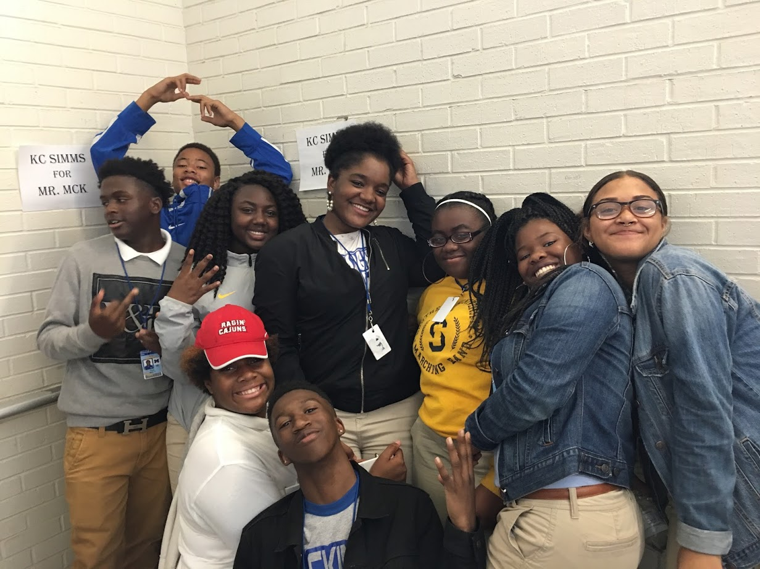
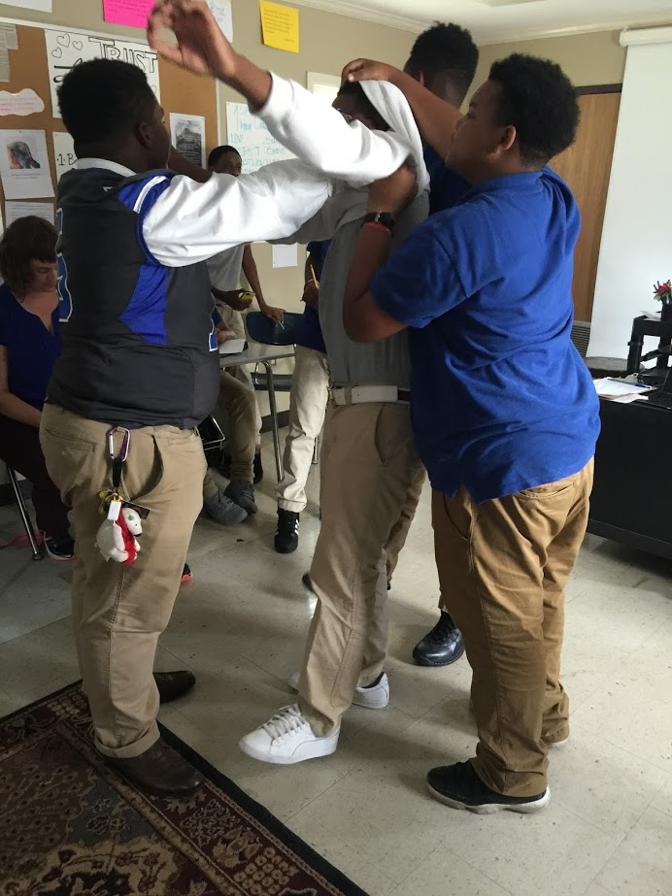
Today’s Agenda
Friday, October 7, 2016
Opening Inquiry & Objective
Restorative Justice Circle
CPAR: Sidewalk Science
Reflection
FAF
Announcements:
REMIND: Text @6a9hh to 810-10
Sidewalk Science: Monday
PLEASE BRING BOOKS!
Notes:
Supplies: laptops,

Slide 3
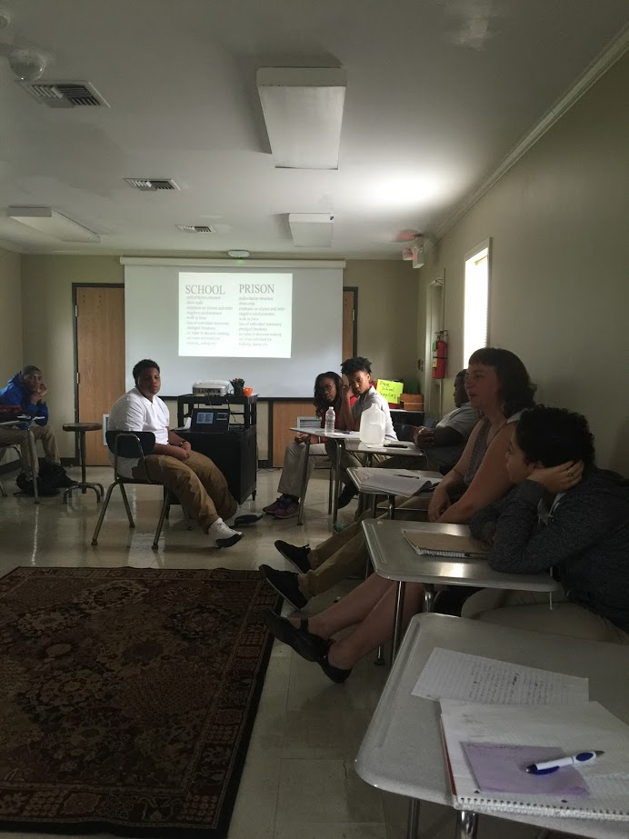
Circle Guidelines
Friday, October 7, 2016
Can you remember the circle guidelines?
Listen from the heart
Speak from the heart
Trust you will know what to say
Say just enough
Who can talk?
Only the person with the talking piece.
Notes:
Supplies: laptops,

Slide 4
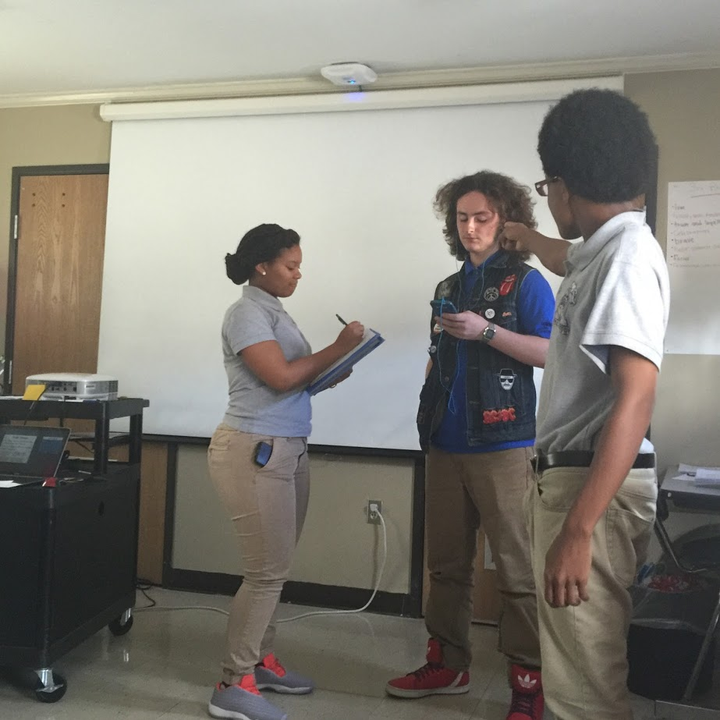
Circle: Opening
Dedication
What is an example of a time when something someone did affected the feelings of others around them. Don’t use names.
I feel ____ when others ____.
Notes:
Supplies: laptops,

Slide 5
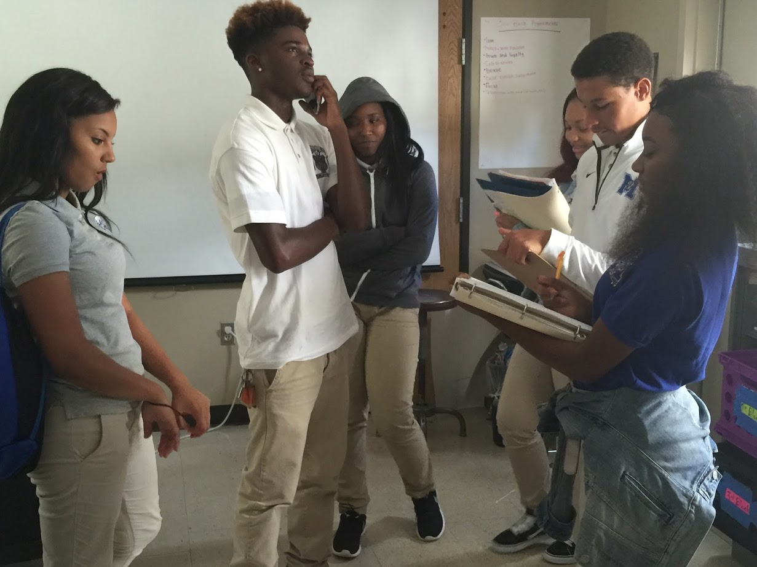
Circle: Brainstorm
Friday, October 7, 2016
Ripples
Every action we take also sends out ripples into our lives.
People are affected differently depending upon what type of ripple we are sending out.
What are some examples? Make a list of things people do that send ripples out into our classroom and our school.
Which do we like? Which don’t we like?
Notes:
Supplies: laptops,

Slide 6
Circle: Agreements
Friday, October 7, 2016
We will get to explore this more in future circles, and we will learn a way to reduce unwanted ripples.
For these discussions, our agreements will be important.
We need to review the “meta-agreements.”
Meta-Agreements
Anyone can ask for an agreement at any time.
Anyone can modify an agreement at any time.
If there is no consensus about a proposed agreement, it is not an agreement.
Maintaining the agreements is everyone’s responsibility (not just the teachers’).
Notes:
Supplies: laptops,

Slide 7
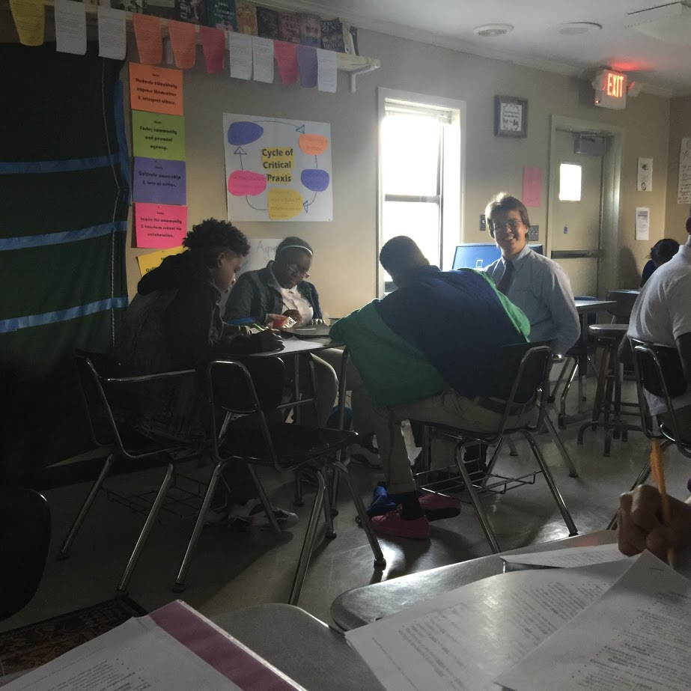
Circle: Close
Friday, October 7, 2016
Share Out:
If you’ve been stepping up, share one thing from the list that made today’s discussion most relevant to your personal experience of the class.
If you’ve been stepping back, please take a risk and share two or three words about your personal experience of today’s circle.
Notes:
Supplies: laptops,

Slide 8
CPAR: Sidewalk Science
Friday, October 7, 2016
Secretaries: Make a chart on the board
Student voice can.. | People who contribute to or benefit from school climate… | Components of school climate
Inspire Generate Create | Students Teachers Administrators | Rules and Norms Sense of Physical Security Sense of Social-Emotional Security (SEE CHART)
Student voice matters because…People can … VERB FROM LIST to … IMAPCT ON SCHOOL CLIMATE COMPONENT
New Pictures TODAY!
Notes:
Supplies: laptops,

Slide 9
FAF!
Friday, October 7, 2016
Notes:
Supplies: laptops,

