Slide 1
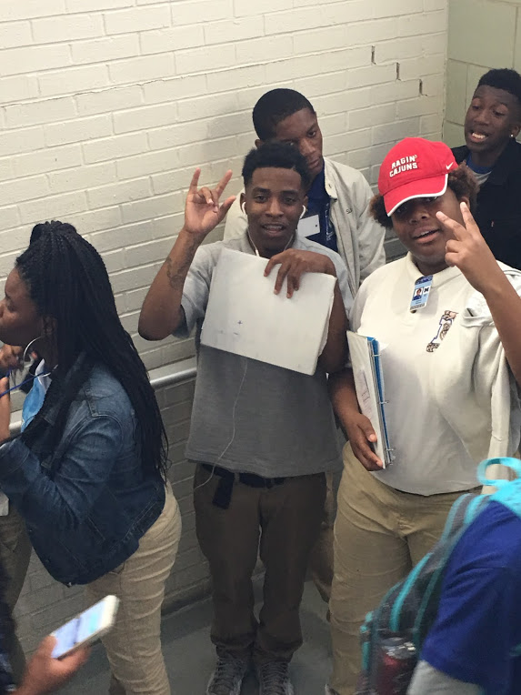
English Amped
Opening Inquiry
Wednesday, October 12, 2016
Objective:
Analyze text for literary elements
Revise writing for significance/explanation
Reflect on Sidewalk Science
Explain and investigate school climate and student voice.
Instructions:
Put a heading on a paper with the title: Sidewalk Science Reflection in the CLASSWORK section.
Think about your Sidewalk Science preparation and presentation to answer the following:
What did we do well?
What could we do better?
What did you learn?
Final Question:
What grade would you give yourself on your Sidewalk Science project? Why?
Notes:
Supplies: laptops,

Slide 2
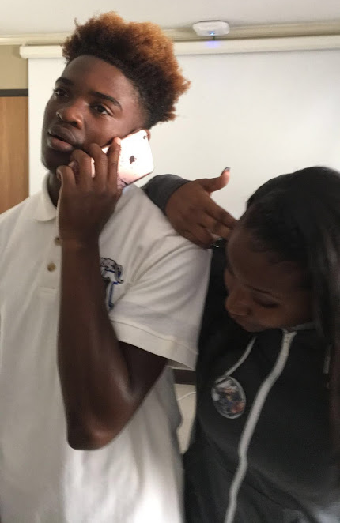
Today’s Agenda
Wednesday, October 12, 2016
Opening Inquiry & Objective
Opening Meeting
Sidewalk Science Reflection
Connection to Research
Seminars
Book Clubs: Chapter 4
CPAR: Proposals and Surveys
Writing Workshop: Revising
Announcements:
Sidewalk Science: Last Day!
PLEASE BRING AAB BOOKS!
Pictures: www.tinyurl.com/2017-EngAmpPhotos
Notes:
Supplies: laptops,

Slide 3
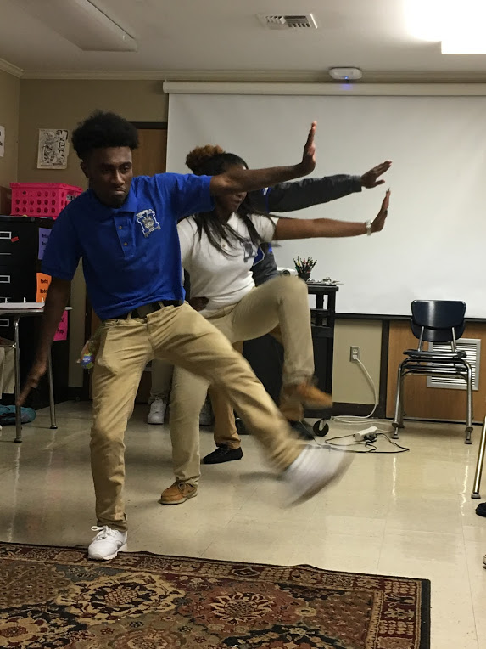
Sidewalk Science Reflection
Wednesday, October 12, 2016
RIGHT NOW: Upload pictures to www.tinyurl.com/2017-EngAmpPhotos
Think about your preparation and presentation to respond:
What did we do well?
What could we do better?
What did we learn?
Future Research
Categorize Analyze Data from Sidewalk Science
Proposals for each audience
School-wide survey for all students
Realistic Hope!
Notes:
Supplies: laptops,

Slide 4
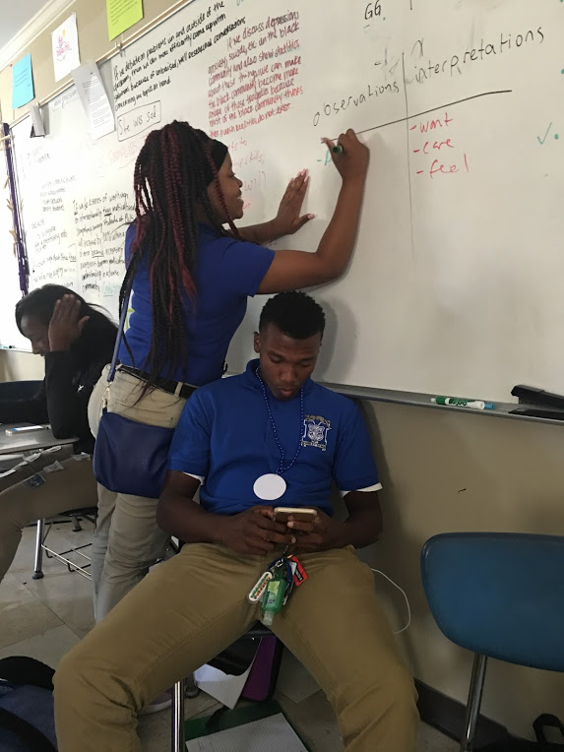
Seminars
Wednesday, October 12, 2016
Book Clubs: Read Chapter 4 & work on sheets
Connectors
Discussion Directors
Writing Workshop: Revise
Illustrators
CPAR: Proposals and Surveys
Device Detectives
We will hold one 45-minute seminar each day, M-Th. Your group will attend a different seminar each day.
Notes:
Supplies: laptops,

