Slide 1
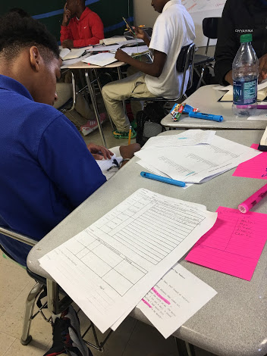
English Amped
Opening Inquiry
Monday, October 17, 2016
Instructions:
Put a heading on a paper in your Literary Analysis section with the title: RATE on Theme.
Use this template, your book club sheet for chapter 4, and the packet to complete this claim about theme: The authors use _____ to convey the theme that ______.
Example: The authors use the spirometer to convey the theme that healing requires a struggle.
Objectives:
Analyze text for literary elements & theme
Evaluate model CPAR projects & articles
Summarize & analyze an article
Categorize data for sidewalk science
Notes:
Supplies: laptops,

Slide 2
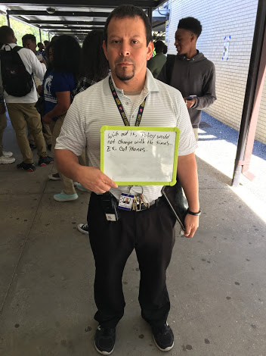
Today’s Agenda
Monday, October 17, 2016
Opening Inquiry & Objective
Opening Meeting
Book Clubs
Discussion
RATE
Seminars
Book Clubs: Chapter 5
CPAR: Dialogue Preparation
CPAR: Evaluating Models
Announcements:
Coronation Tuesday 6 PM @ McK
Homecoming Game Friday @ 7PM
Tomorrow: Dynamic Duo
Notes:
Supplies: laptops,

Slide 3
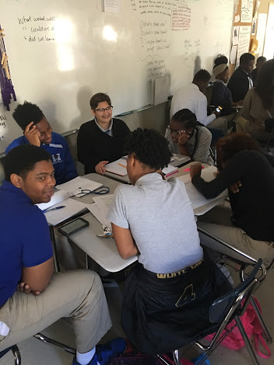
Book Clubs: Discussion
Monday, October 17, 2016
Discussion Director leads the discussion. Ask
Your questions.
Members to refer to their sheets.
Members to refer to their theme.
Illustrator keeps time.
Device Detective completes reflection.
Connector turns in the RATE paragraphs.
Notes:
Supplies: laptops,

Slide 4
Book Clubs: RATE
Monday, October 17, 2016
Use the claim you wrote for the Opening Inquiry in your Literary Analysis section.
Use the template to the left to complete your paragraph, or nah.
Turn into the tray when done.
Read over instructions for your group’s seminar or get ready for book club if you finish early.
TEMPLATE
The authors use __________ to convey the theme that ____________. For example, on page ___, _______ says, “QUOTE.” This excerpt illustrates __________. By using ___________ as a symbol for __________, the authors convey the theme that ___________. This is important to readers because _______________. Further, readers can _____________. Therefore, the authors inspire the readers to ____________.
Notes:
Supplies: laptops,

Slide 5
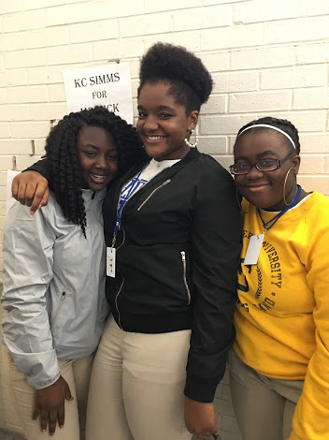
Seminars
Monday, October 17, 2016
Book Clubs: Read Chapter 5 & work on sheets
Discussion Directors
Device Detectives
CPAR: Dialogue
Connectors
CPAR: Evaluating Models
Illustrators
We will hold one 45-minute seminar each day, M-Th. Your group will attend a different seminar each day.
Notes:
Supplies: laptops,

Slide 6
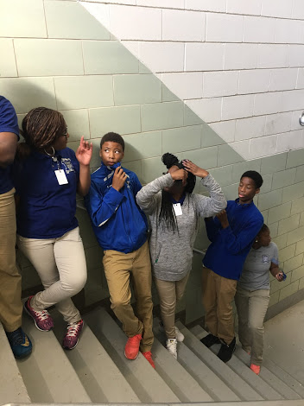
Reflection
Monday, October 17, 2016
What did we learn? Let’s hear from 1 person in each group.
Objectives:
Analyze text for literary elements & theme
Evaluate model CPAR projects & articles
Summarize & analyze an article
Categorize data for sidewalk science
Notes:
Supplies: laptops,

