Slide 1
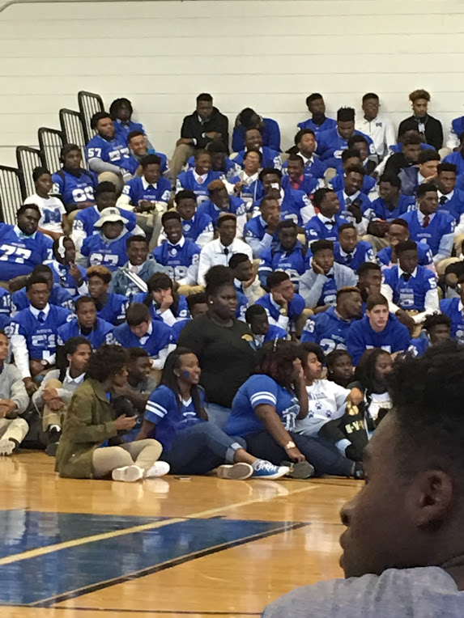
English Amped
Opening Inquiry
Tuesday, October 25, 2016
Instructions:
Get the Book Club Sheet for your meeting 6 role (new groups).
Open your All American Boys book to “Wednesday: Quinn” on page 207:
Discuss with your group: What do you think will happen from Quinn’s perspective in “Wednesday”?
We are meeting the authors Thursday, so let’s do our best to prepare for them!
Notes:
Supplies: laptops,

Slide 2
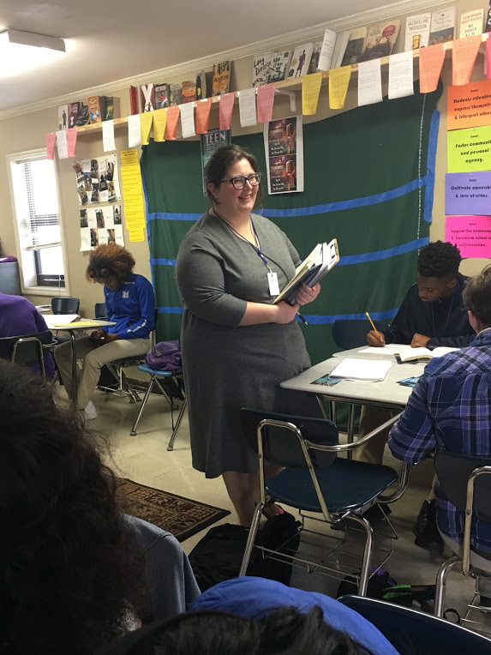
Today’s Agenda
Tuesday, October 25, 2016
Opening Inquiry & Objective
Opening Meeting
Book Clubs: Chapter 6, “Wednesday: Quinn”
Dialogue Introduction
Facilitation
White Privilege
Critical Race Lens
Announcements:
Field Trip Oct. 27: AAB authors
Objective:
Analyze text for literary elements and theme through book club sheets and discussion
Generate knowledge about and analyze white privilege
Notes:
Supplies: laptops,

Slide 3
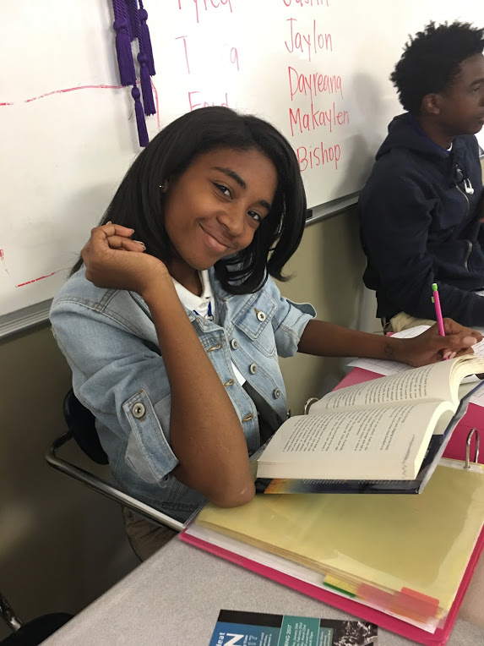
Book Clubs: Chapter 6
Tuesday, October 25, 2016
The teachers will read inside.
You can fill in your sheet as we read or not.
At the end of “Quinn,” we will have 10-15 minutes to work on book club sheets.
Discuss, but don’t copy.
Find different examples
Use page numbers and specific passages.
Include significance!
Notes:
Supplies: laptops,

Slide 4
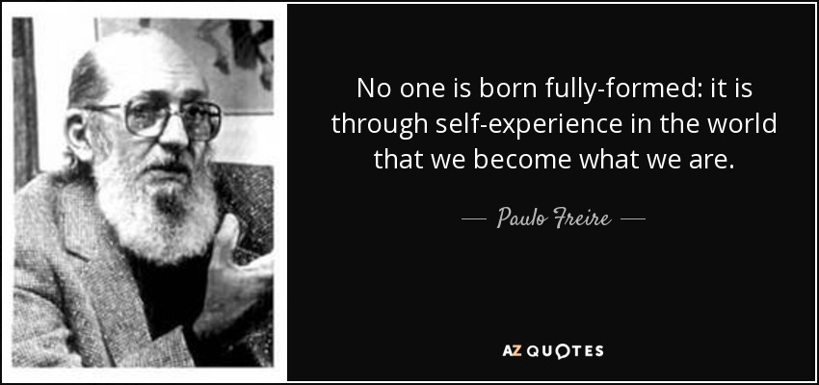
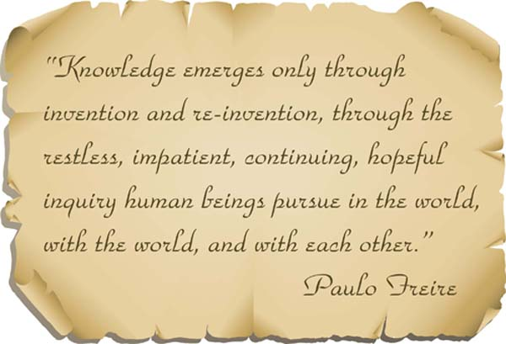
Dialogue: Intro
Tuesday, October 25, 2016
Purpose: Distinctions between Dialogue, Debate, and Discussion
Preparation: Mark what stands out to you.
Critical Race Lens: Reading the word and the world
Outside Circle
Facilitation: Take field notes on the tactics Mrs. Cooper uses and participants’ responses to those tactics.
Questions: Write down responses you want to share so you don’t forget them.
Notes:
Supplies: laptops,

Slide 5
Dialogue Round 1
Tuesday, October 25, 2016
What stands out to you in the text for any reason?
How have you seen or experienced white privilege?
What will you do with this new knowledge? How can you read the word and the world differently? In other words, how can you apply a critical race lens to various written and unwritten texts?
I agree with her/him because….
One question I have is…
I don’t understand why/how…
This example may help…
We are assuming that…
What I hear you saying is…
To answer this question, we need to know…
The main issue seems to be…
Something that people haven’t brought up yet is…
Notes:
Supplies: laptops,

Slide 6
Dialogue: Switch!
Tuesday, October 25, 2016
Purpose: Distinctions between Dialogue, Debate, and Discussion
Preparation: Mark what stands out to you.
Critical Race Lens: Reading the word and the world
Outside Circle
Facilitation: Take field notes on the tactics Mrs. Cooper uses and participants’ responses to those tactics.
Questions: Write down responses you want to share so you don’t forget them.
Notes:
Supplies: laptops,

Slide 7
Dialogue Round 2
Tuesday, October 25, 2016
What stands out to you in the text for any reason?
How have you seen or experienced white privilege?
What will you do with this new knowledge? How can you read the word and the world differently? In other words, how can you apply a critical race lens to various written and unwritten texts?
I agree with her/him because….
One question I have is…
I don’t understand why/how…
This example may help…
We are assuming that…
What I hear you saying is…
To answer this question, we need to know…
The main issue seems to be…
Something that people haven’t brought up yet is…
Notes:
Supplies: laptops,

Slide 8
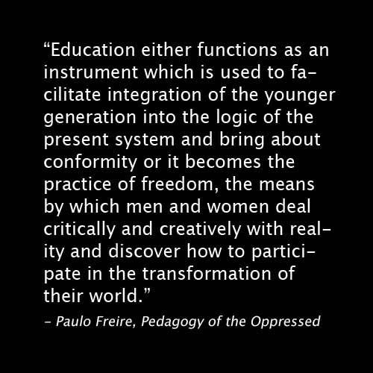
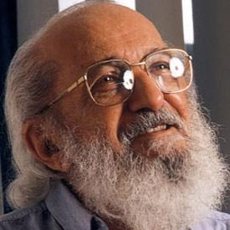
Reflection
Tuesday, October 25, 2016
Objectives:
Analyze text for literary elements and theme through book club sheets and discussion
Generate knowledge about and analyze white privilege
Reflection
What did we learn?
How will you apply what you learned today in the future?
Notes:
Supplies: laptops,

