Slide 1
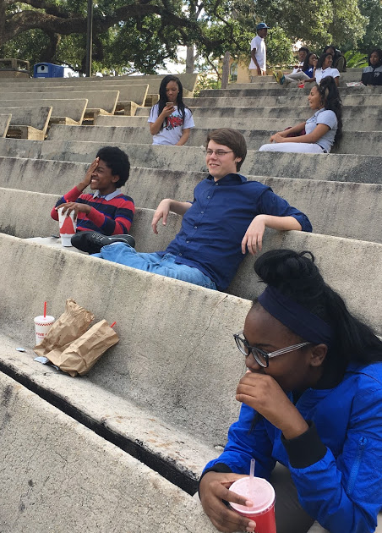
English Amped
Opening Inquiry
Wednesday, November 9, 2016
Instructions (5 min.):
Put a heading on a paper in your Classwork Section with the title: “Election”
Free write about your thoughts on the election results.
Notes:
Supplies: laptops,

Slide 2
Today’s Agenda
Wednesday, November 9, 2016
Opening Inquiry
Objectives & Meeting
Election Discussion (10)
Evidence Charts (30)
ORWS (40)
Portfolio Conferences
Teacher Writing Conferences
Individualized Writing
Reflection (5min)
Announcements:
Vision and Hearing Screening today and tomorrow
School-Wide Survey Thu. 11/10
Objectives:
Analyze text for literary elements & theme in an essay with proper citations.
Generate, conference, and apply feedback in revisions in ORWS
This Week in English Amped:
Wednesday: See Agenda
Thursday: “Five Faces” (?) and AAB Works Cited entries and Essays; ORWS-revisions
Friday: Restorative Justice Circle; Class structure surveys; FAF
Notes:
Supplies: laptops,

Slide 3
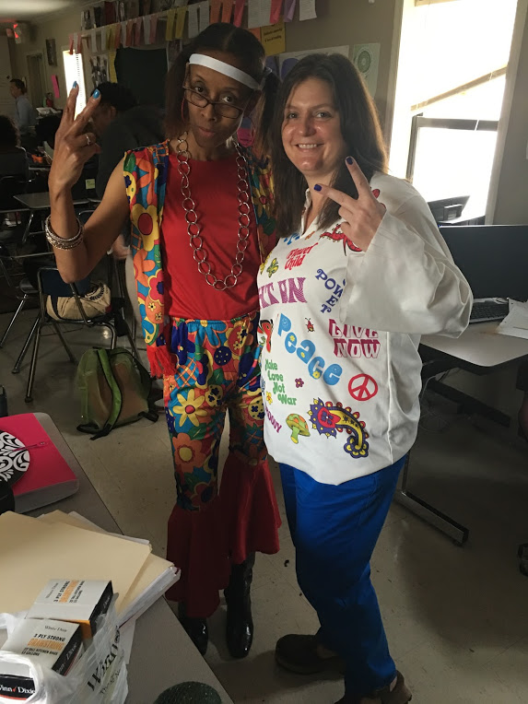
Evidence Charts
Wednesday, November 9, 2016
Use the novel and your book club sheets to find page numbers for specific references to evidence that supports the claims in your essay.
Use ellipses & citations to quote lengthy text excerpts:
“First three words…last three words” (11).
“1st 3 words…last 3 words” (22-23).
Notes:
Supplies: laptops,

Slide 4
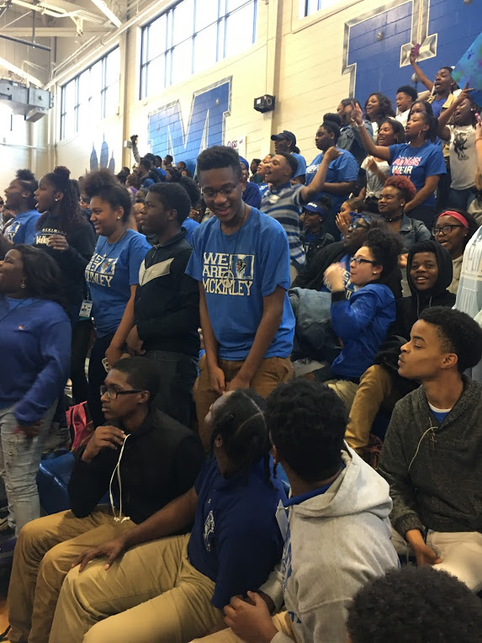
ORWS
Wednesday, November 9, 2016
Conference with Mrs. Cooper on Portfolios
Conference with Mr. Biddick on one piece of writing
While waiting on your conferences, choose to
Free write
Write or revise a RATE paragraph, essay, or genre of choice.
RATE or Essay: “Five Faces”
Must produce something to turn in.
Notes:
Supplies: laptops,

Slide 5
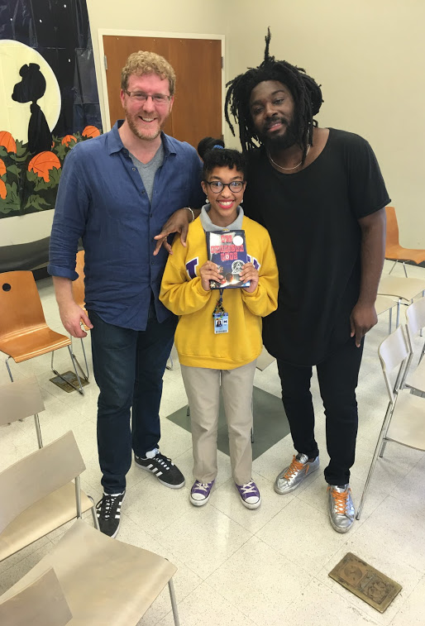
Reflection
Wednesday, November 9, 2016
What did we learn?
Objectives:
Analyze text for literary elements & theme in an essay with proper citations.
Generate, conference, and apply feedback in revisions in ORWS
Notes:
Supplies: laptops,

