Slide 1
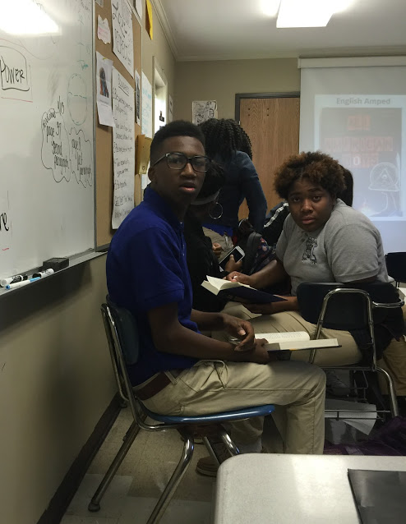
Opening Inquiry
Tuesday, September 27, 2016
Instructions:
Describe an experience that changed your opinion on something. This will go in your ORWS section of your binder.
English Amped
Notes:
Supplies: laptops,

Slide 2
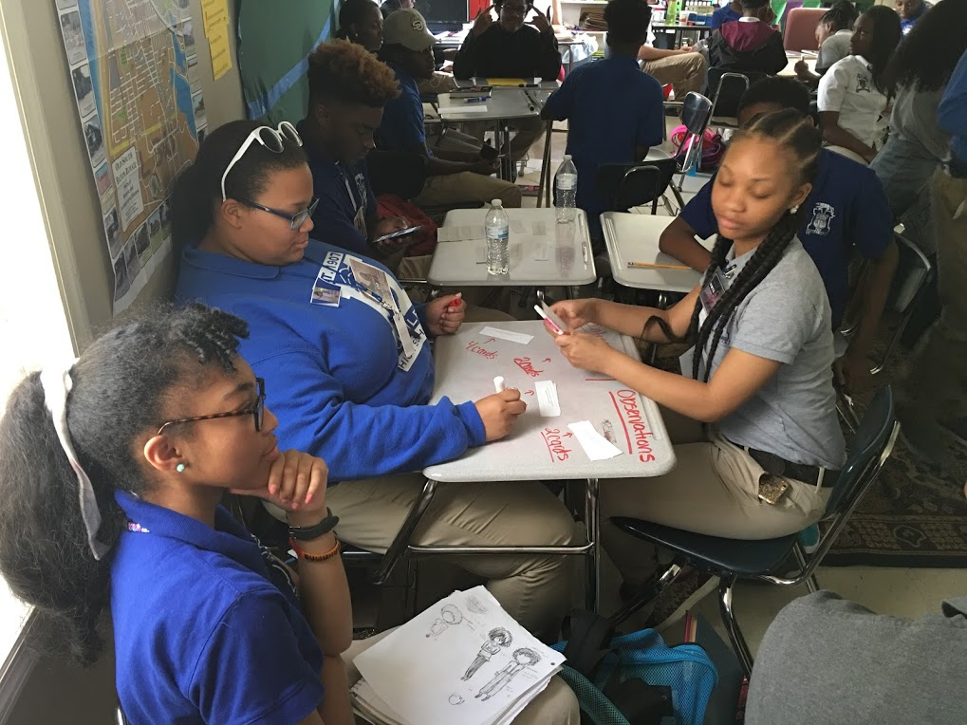
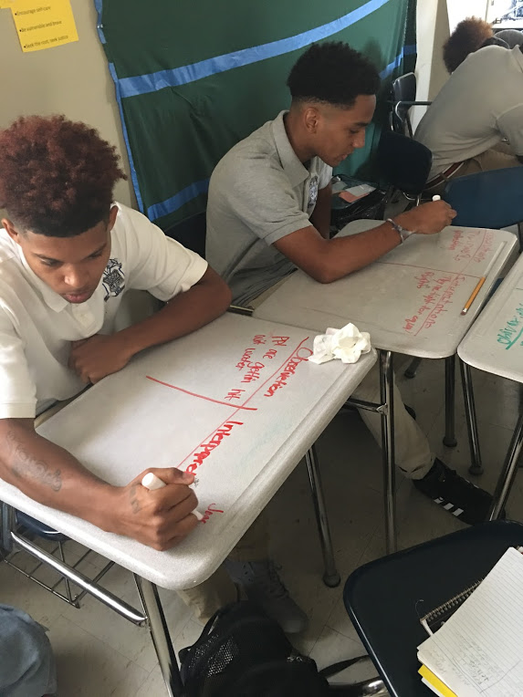
English Amped
Today’s Agenda
Tuesday, September 27, 2016
Opening Inquiry
This I Believe essay workshop
Book Clubs
Announcements:
REMIND: Text @6a9hh to 810-10
PSAT Test: $15 due by 9/22 in B106
(www.EnglishAmped.weebly.com)
Notes:
Supplies: laptops,

Slide 3
This I Believe Workshop
Prewriting:
Read model essay.
Share seed stories in your group.
Brainstorm experiences and the beliefs they represent.
Write an outline of your experience.

Slide 4
This I Believe Workshop
Write!
If you are stuck, you can:
Read another model essay.
Mimic the structure of one of the essays.
Discuss with a friend.
Ask me for help.

Slide 5
Book Clubs
Finish Chapter 2: Quinn.
Complete contribution sheets.
Collaborate with your group to make sure everyone is ready for discussion.

