Slide 1
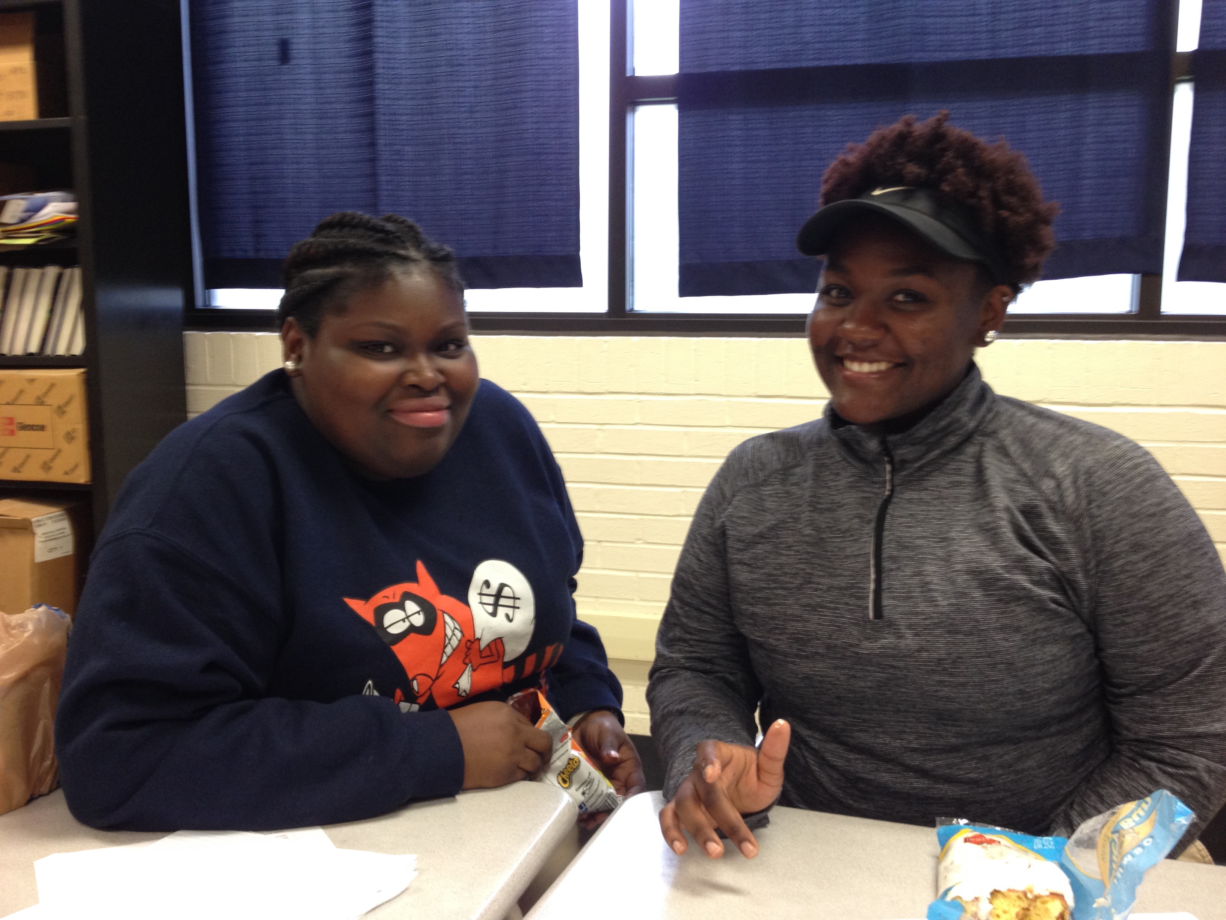
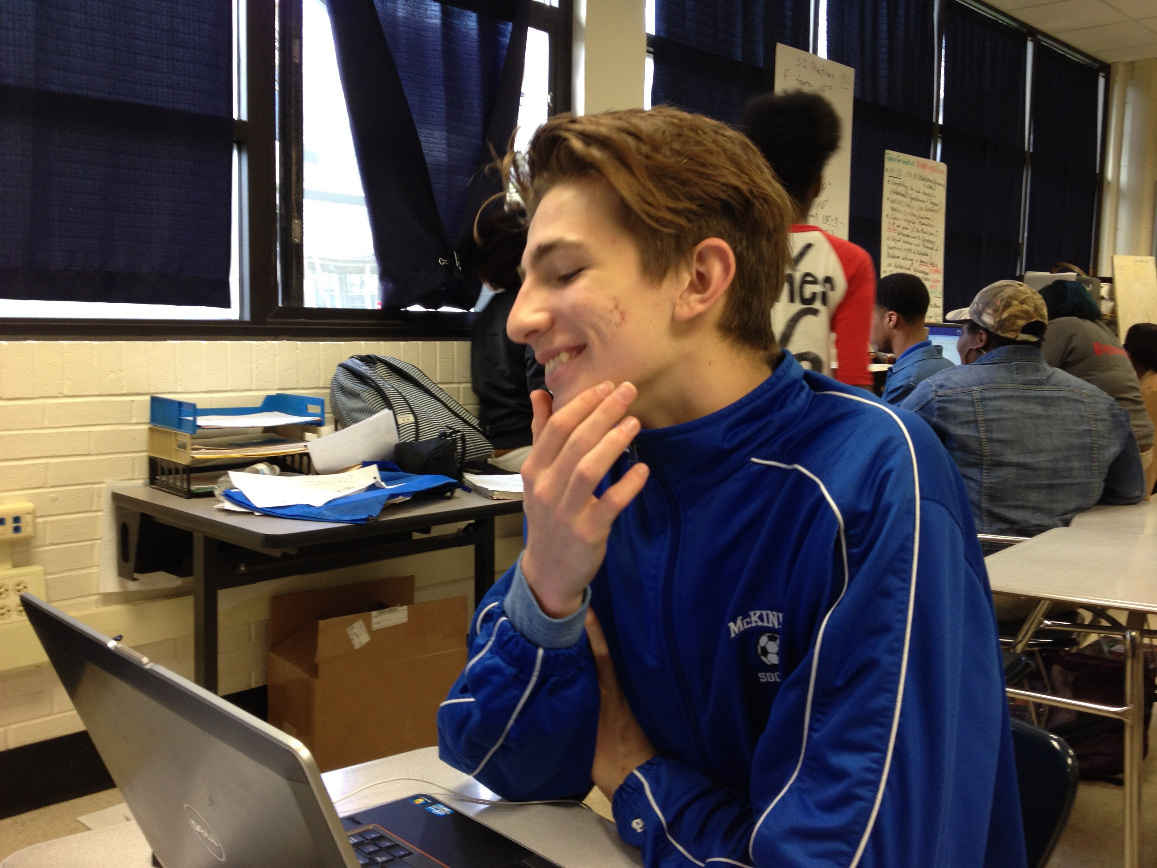
English Amped IV
Today’s Agenda
Tuesday, September 6, 2016
Welcome back! (15 min)
The best thing…one lesson…
Survey http://tinyurl.com/SurveyMcK2016
Evaluate Last Spring Student Survey Findings & Present (30)
Syllabus, Materials, Boundaries & Restorative Process (30)
Class Agreements (15)
Get Book Club Choices & rank (HW)
To Do:
Bring back media waiver
Get supplies (Choice):
1 5-Subject Notebook; 1 Binder with 5 tabs; OR 5 single-subject notebooks
RANK top four choices for book club
Notes:
Supplies: laptops,

Slide 2
Mingle, Cluster
Form four groups of 6-7 people

Slide 3
Student Feedback //English Amped Junior Class 2015-2016 Report Prepared by Anna West & Destiny Cooper
In May 2016, we gathered short answer surveys from 21 respondents in our junior class to gain students’ insights and ideas for the coming year. Following is a compilation of student responses on the survey organized into thematic codes.

Slide 4
Get Into Groups, Choose Topic
Each Group Choose a Data Section
Part 1: What worked?
Part 2: What needed improvement?
Part 3: What mattered most?
Part 4: What did students want for this year?

Slide 5
Read Report and Prepare to Present
Read over your section as a group
Use chart paper to prepare a short visual and oral presentation that summarizes your section for the rest of the class

Slide 6
Teacher Take-Aways
As teachers of the 2016-2017 Senior English Amped class, our major take-ways from students’ perceptions of the class at the end of their Junior year are the following:
Community matters, but it’s not always easy. Take time to care for community, and hold high expectations for how people treat one another because it is both a great source of joy and frustration for members of the class when people are not treating the class and one another with respect and care. Use community building, conflict resolution, and clear communication to foster an even stronger community.
Freedom matters, but it’s not always easy either. There needs to be a balance between the freedom and accountability that students experience in English Amped. This is closely connected to student ownership in learning and in trusting that self-selected and teacher-selected lessons are valuable and therefore deserve the attention, importance, and quality that accountability generates in learning.

Slide 7
Teacher Take-Aways
Organization matters. Teachers needs to have a clear plan that articulates goals, timelines, and grades so that students can understand how to manage their freedom and responsibilities within boundaries set up by the teachers. Likewise, students will take ownership of their own organization and adhere to the organizational requests of teachers to assist teachers in maintaining overall classroom organization.
Young people are powerful agents of change. There is a powerful, capable group of people assembled in this class. This group is even more powerful now because students understand the creative impact they can have on education and on the lives of other young people who also deserve to be heard.
Students want to have an amazing, impactful, interactive, joyful, fun senior year. Let’s do it!

Slide 8
Syllabus: One Path to Ownership
Read over the Syllabus Silently.
What is one goal of English 1001? One outcome?
What percentage of 1001 DE grades will be earned this fall?
What percentages are deducted for late work?
What do you notice about Get Right?
How many grades do you get for
Homework?
What is your first major assignment?
What’s different? Where’s CPAR? Open Mics?

Slide 9
Take Note: Materials and Resources
Daily Materials: Writing Utensils + Choice of
One binder with 5 Tabs, Loose Leaf, & One Folder, OR
One 5-Subject Notebook & One Folder, OR
5 Single-Subject Notebooks & One Folder
Semester Portfolio: Binder or Weebly Website (in class)
Book Club #1: TBD in next class
Class Resources:
www.englishamped.weebly.com

Slide 10
Boundaries & Restorative Process: Another path to ownership
Read over the Guidelines Silently.
What are the five boundaries?
Who enforces the boundaries?
What is the main difference between a restorative and disciplinary process?
How do you request a restorative dialogue?
What are class agreements?
What is different from last year?

Slide 11
Class Agreements
What do you need from your classmates, teachers, and self in order to be productive and happy in this class?

Slide 12
To Do:
Bring back media waiver
Get supplies (Choice):
1 5-Subject Notebook & folder; OR 1 Binder with 5 tabs; OR 5 single-subject notebooks & folder
RANK top four choices for book club

