Slide 1
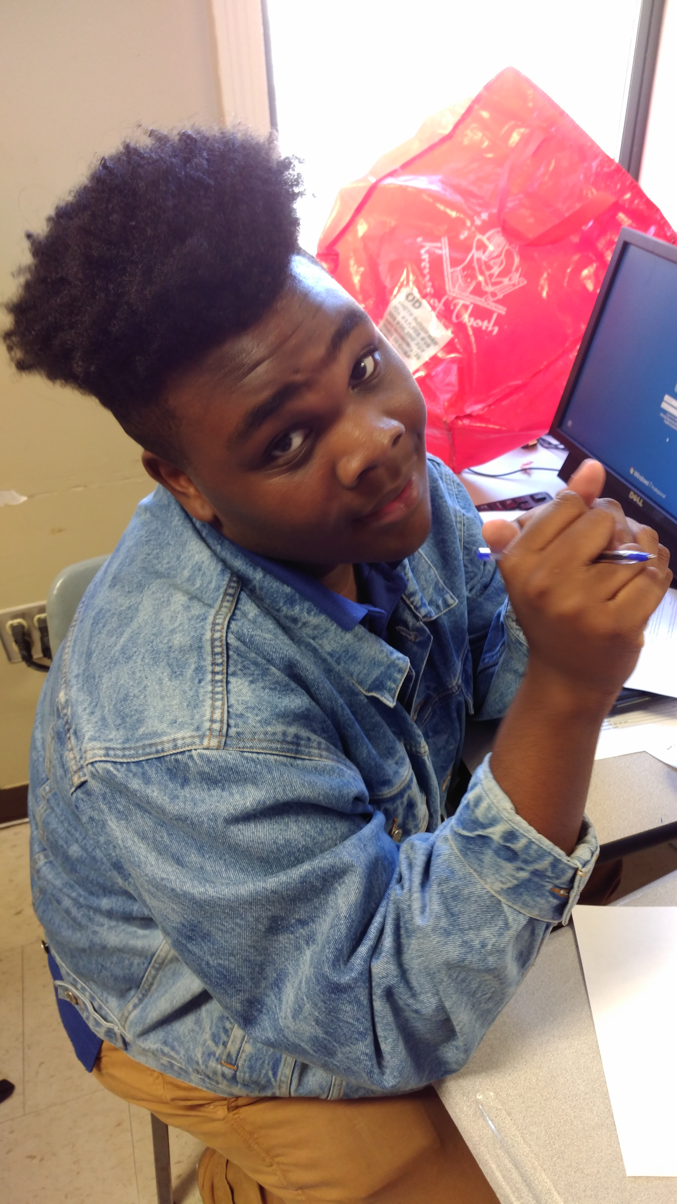
Humanities Amped People, Power, Publication
Today’s Agenda
Friday, September 23, 2016
Set up: Semi-Circle
5 min. Life Story
Revisit Class Committee Plans: Grades
First major deadline: Call to action
In project groups: Strengthen goals, revise theories of change
Announcements/HW:
Begin working on your call to action!
Notes:
Supplies: laptops,

Slide 2
What do we need to be successful? How do we enable our shared leadership?
A Fair and Open Grading System:
Review and try out today

Slide 3
Organizing Definition
Organizing is leadership that enables people to turn the resources they have into the power they need to make the change they want.
Check out your organizer’s handbook! Class set.

Slide 4
First Deadline: Call to Action
See handout with model and components.

Slide 5
Strategic Goals, Theory of Change
Read p. 34 on effective strategic goals.
Revise your theory of change accordingly:
If….
Then…
Because…
Revised draft of strategic goal due today for 10 pts.

Slide 6
Meet Professor Ganz: AKA, Get it from the source.
Senior lecturer
in public policy at
Harvard University.
Ganz dropped out of college
to be an organizer with
SNCC during civil rights, and later with the United Farm Workers. He organized the ground campaign for Obama’s first election. After 28 years, he returned to school and is now a professor at Harvard’s Kennedy School.

